Slide 1

Intelligent groups and sparse controls
ITN – SADCO Summer school
"New Trends in Optimal Control”
Ravello, Italy, 3-7 September 2012
Benedetto Piccoli
Joseph and Loretta Lopez Chair Professor of Mathematics
Department of Mathematical Sciences and
Program Director
Center for Computational and Integrative Biology
Rutgers University - Camden

Slide 2
Intelligent groups and sparse controls:
Abstract
ITN – SADCO Summer school
"New Trends in Optimal Control”
Ravello, Italy, 3-7 September 2012

Slide 3
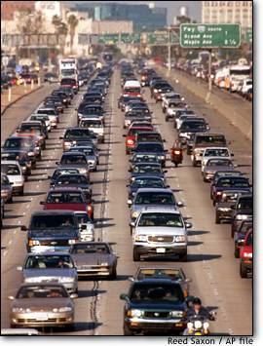
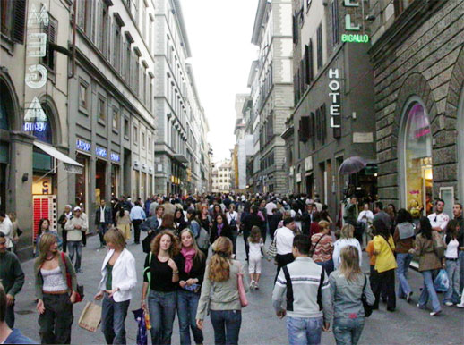
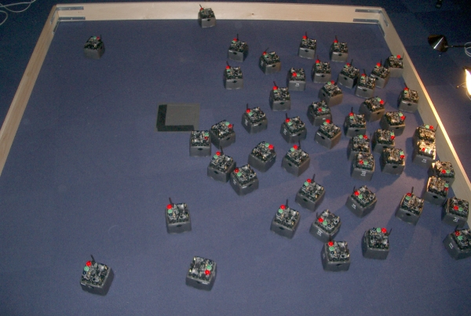
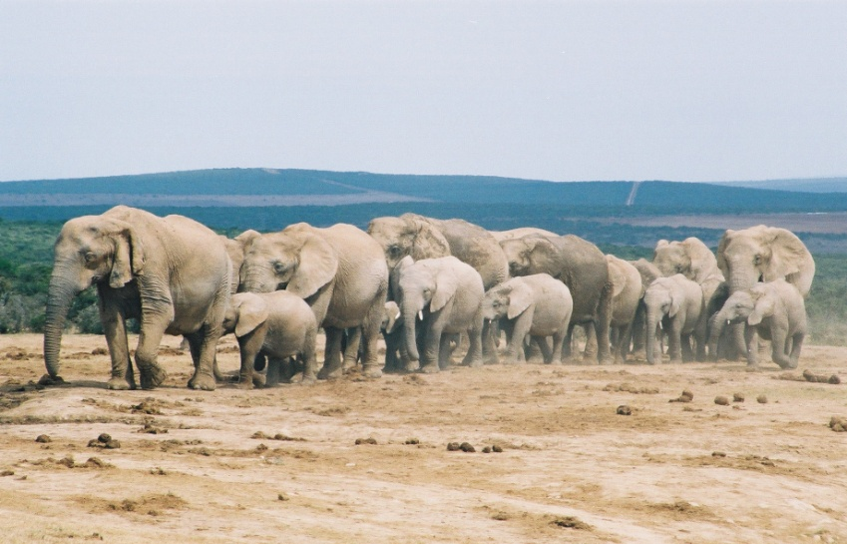
Intelligent groups
Vehicular traffic
Crowd dynamics
Networked robots
Animal groups

Slide 4
Mathematical modeling
Aims:
Understand
Reproduce
Control
Scales:
Microscopic
Macroscopic
Mesoscopic
Experiments
Validation
Measurements
Observations
Integrate scales
Integrate
Numerics
Simulations
Modeling
Analysis
Models:
Discrete or continuous
ODEs or PDEs
Deterministic or
stochastic
Analysis:
Functional space
Metric
Dynamics
Integrate models

Slide 5
Motions of intelligent groups
Gas particles:
Robust
Isotropic
Blind
Local interaction
Energy balance
Intelligent particles:
Fragile
Anisotropic
Vision + decision
Non-local interaction
No energy balance
Vehicular traffic vs Pedestrians, robots and animals:
Dimensionality : 1-D vs 2-D or 3-D
Non locality : one car ahead vs many neighbors
As a result: Entropy vs Self-organization

Slide 6
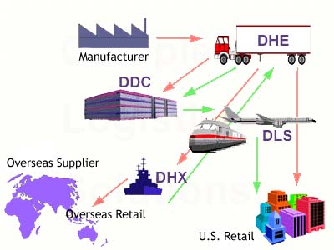
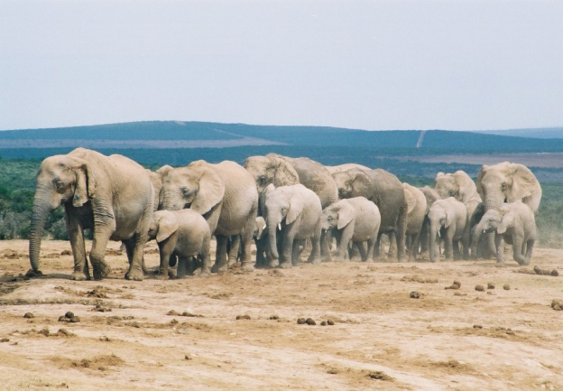

Research and course trajectory

Slide 7
Intelligent groups and sparse controls:
Lecture 1
ITN – SADCO Summer school
"New Trends in Optimal Control”
Ravello, Italy, 3-7 September 2012

Slide 8
Conservation laws on networks
u + f(u) =0
t
x
Dynamics at nodes?
The only conservation at nodes does not determine the dynamics
Additional rules should take into account, as distribution policies
Solutions give rise to boundary value problems on arcs
Entropy is used to determine dynamics (maximal flux)

Slide 9
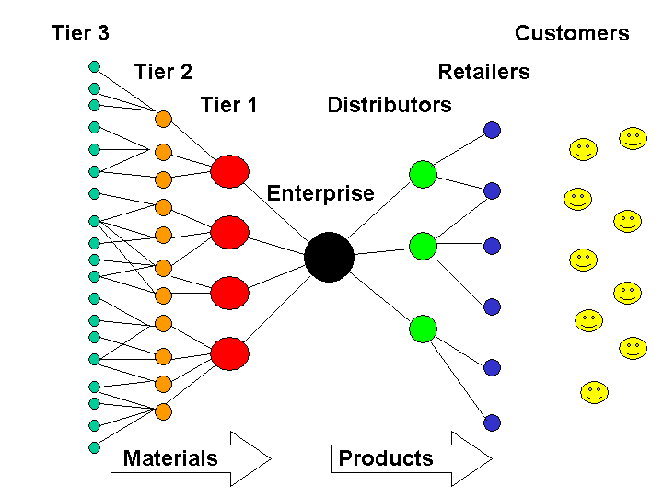
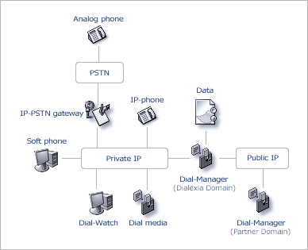
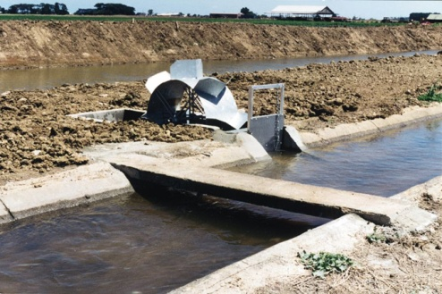
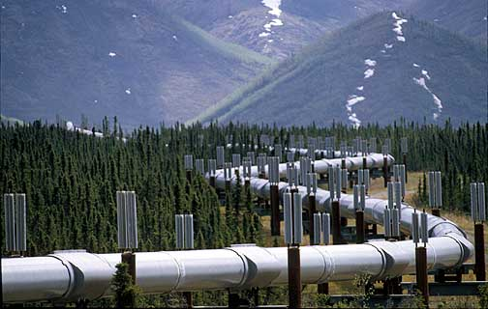
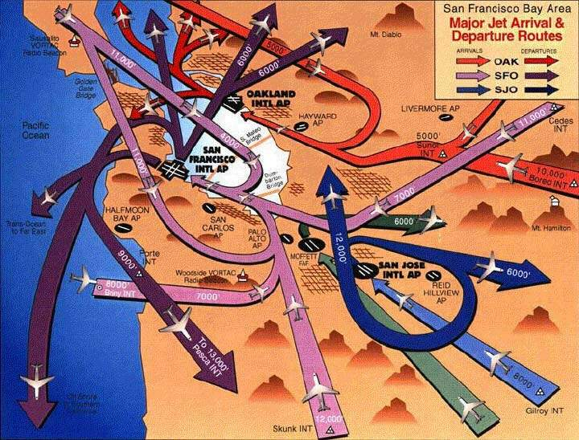
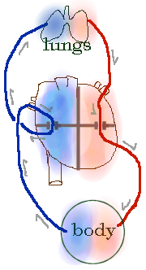
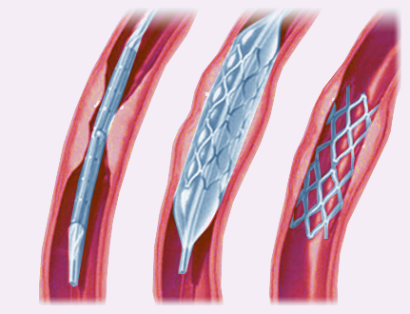
Transportation
Supply chains
Vehicular Traffic
Irrigation Channels
Services/Supply
Tlc and data networks
Gas pipelines
Air traffic management
Bio-Medical
Real fluids
Blood circulation
Vascular stents
Notes:
9

Slide 10

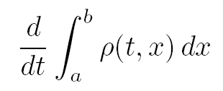
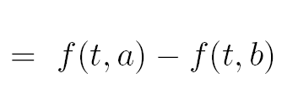
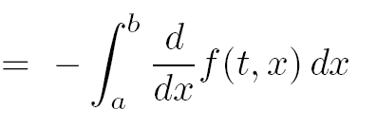
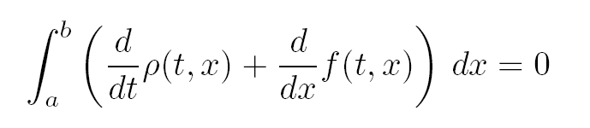
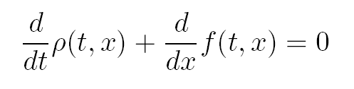
Scales for vehicular traffic
v
MACROSCOPIC
i
x
x
i
MICROSCOPIC
a
b
x

Slide 11

Lighthill-Whitham-Richards model
The flux is given by the density times the average velocity
If we assume that the average velocity depends only on density
Methods of characteristics
velocity
flux
Finite time
Time t=0
Non unique (weak) solutions
Entropy (gas dynamics)
(disorder is increasing, stable shocks)

Slide 12
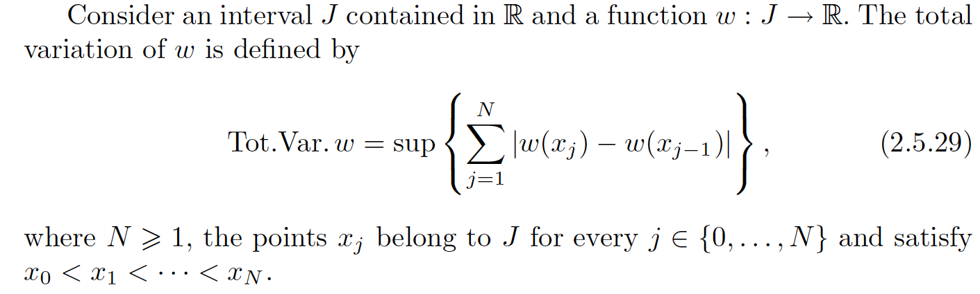
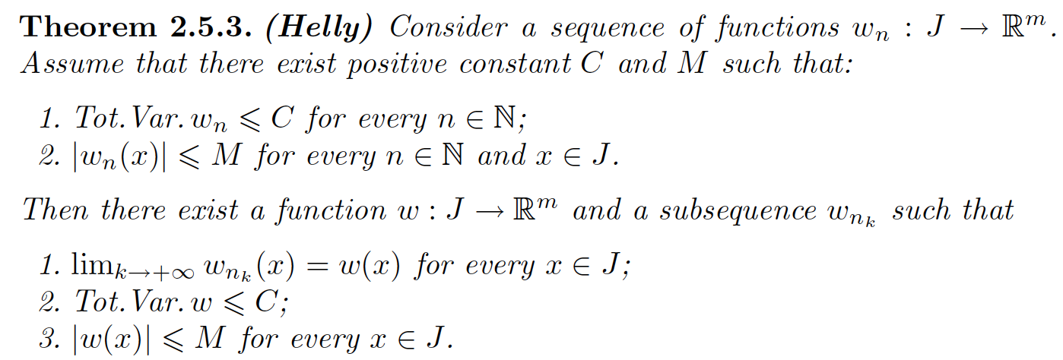
Mathematics of conservation laws
BV functions
Example: piecewise constant functions
T.V. = Σ Δ < +∞
Δ
Δ

Slide 13
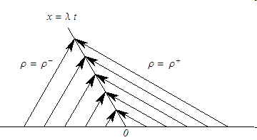
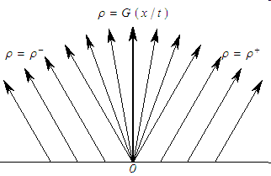
Solution to the Riemann Problems
Cauchy problems with Heaviside type initial datum : (ρ -, ρ +)
For a concave flux function, the RP has a unique entropically admissible weak solution.
Shock
Rarefaction

Slide 14
Mathematics of conservation laws
Wave front tracking
Estimates on:
Number of waves
Number of interactions
T.V. of solution
Shock
Rarefaction
t*
u₁
u₂
u₃
u₄
u₅
…
Riemann problem

Slide 15
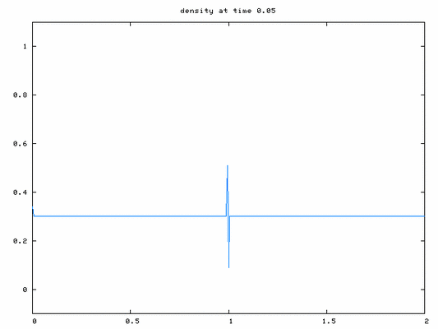
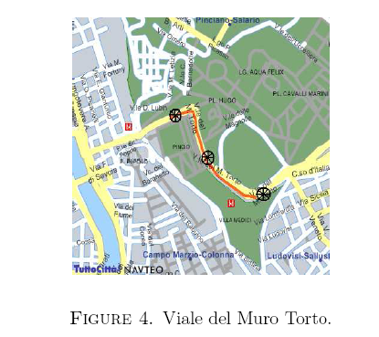
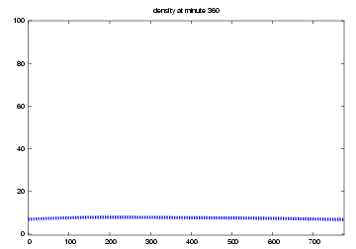
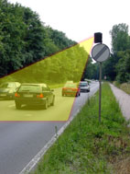

Traffic lights and Viale del Muro Torto
Data reconstruction error: 9% free phase, 19% congested phase
0
2
1
Continuous flow reconstructed from spot (discrete) data

Slide 16

Dynamics at junctions
Rule (A) : Out. Fluxes Vector = A · Inc. Fluxes Vector
Traffic distribution matrix A = (α ) , 0<α <1, Σ α =1
ji
ji
j
ji
Rule (B) : Max ║Inc. Fluxes Vector║
Rule (B) is an “entropy” type rule : maximize velocity
Applied Math (95-): Holden-Risebro, Coclite-Garavello-P., etc.
Transport Eng (95-): Daganzo, Lebacque-Khoshyaran, etc.
Notes:
16

Slide 17
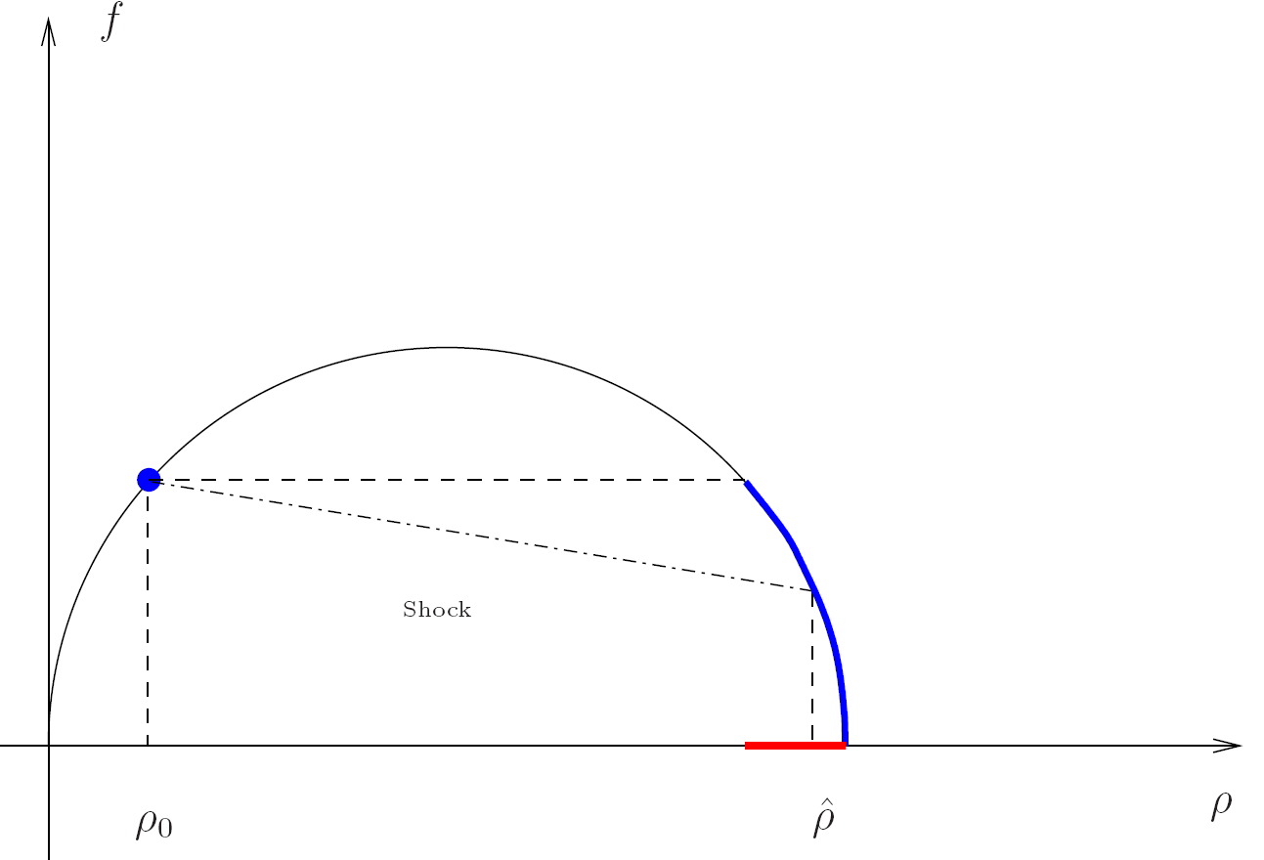
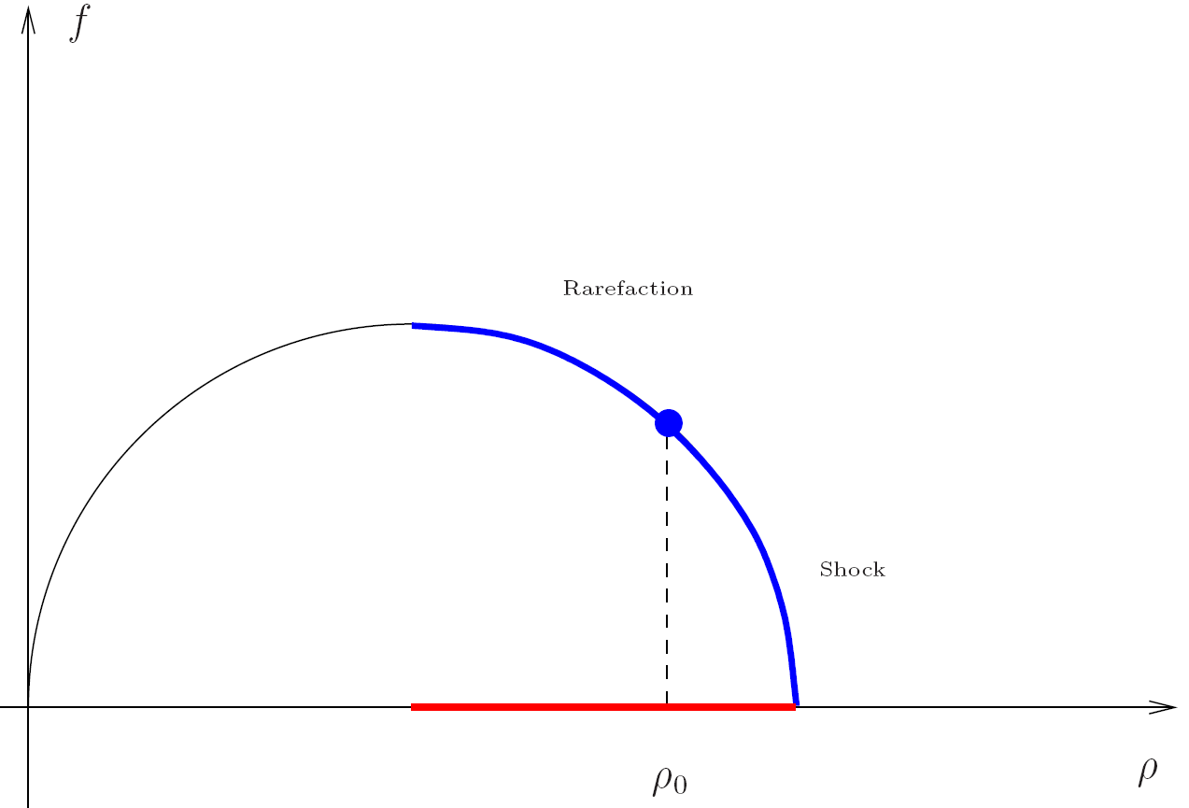
Dynamics at junctions(2)
Traffic distribution matrix A = (α ) , 0<α <1, Σ α =1
ji
ji
j
ji
Rule (A) : Out. Fluxes Vector = A · Inc. Fluxes Vector
Rule (B) : Max ║Inc. Fluxes Vector║
1
(A) implies conservation through the junction
(A), (B) equivalent to a LP problem and a unique solution to RPs
Solutions on roads are given solving boundary value problems.
→Fluxes respect Rules (A) and (B) only if bounday value problems produce
waves with negative velocity on incoming roads and with positive velocity on
outgoing ones.

Slide 18
Wave Front Tracking on networks
t*
t*
1
2
t*
t*
3
4
1
3
2
4

Slide 19
Theory on networks
More incoming than exiting road
Priority parameters
Bifurcations, merging, complicate junctions, traffic circles
Theorem : existence of solutions on networks for BV initial data.
Existence of solutions : bound on BV norm on solution fluxes.
First order increase of TV of solutions : no Glimm functional
TV(t)/TV(0) unbounded
TV(f) bounded but no local in time functional
Road flux total variation in x ~ Junctions flux total variation in t

Slide 20
Mathematics of conservation laws on networks
(P1) Bound on the change in flux variation
ΔT.V.(f ) ≤ C min{T.V.(f )–, ΔΓ}
where Γ is the incoming flux
f_{right}
f_{left}
(P2) Incoming flux
ΔΓ ≤ 0

Slide 21
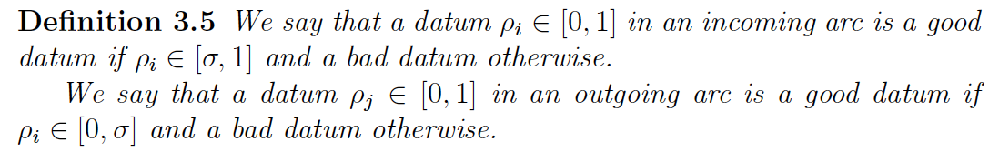
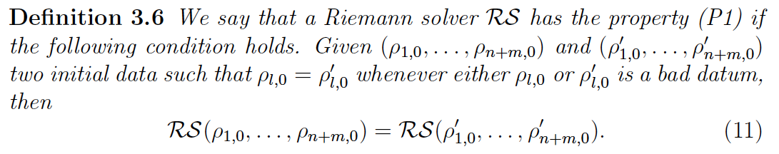
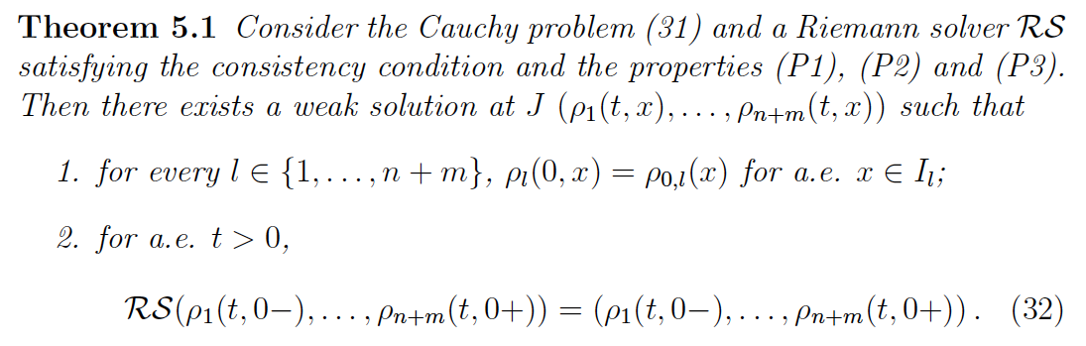
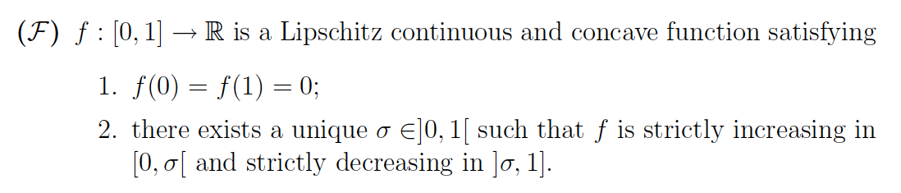
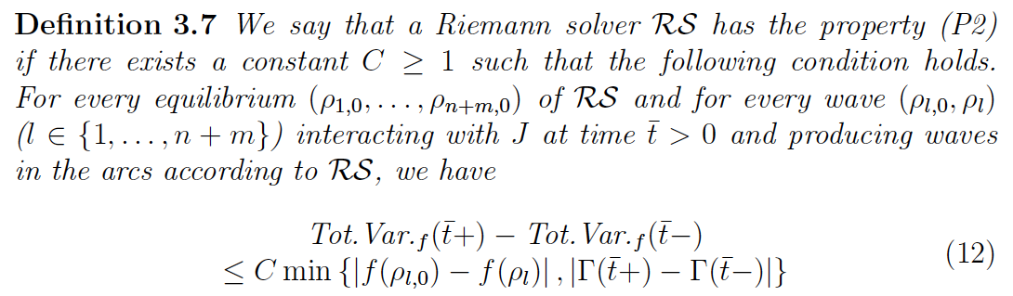
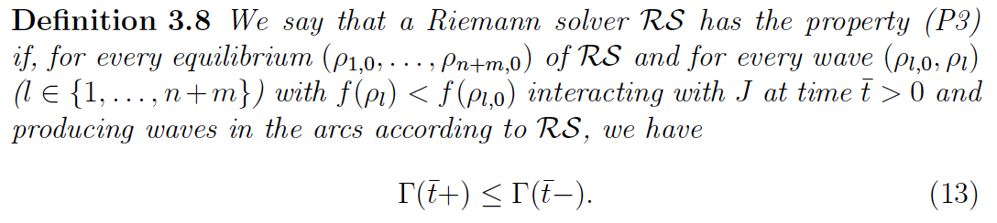

Slide 22
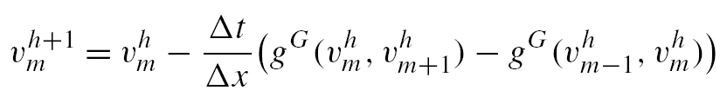
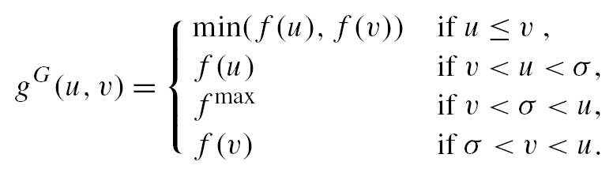
Numerical schemes : Godunov
Approximation schemes (explicit schemes):
Godunovs scheme (first order), Kinetic scheme with 3 vel. of first and second order
Solve Riemann problems
Apply Gauss-Green
Use flows on vertical lines
Godunov scheme reads:
Assume f concave
with unique maximum σ
then numerical flux :

Slide 23
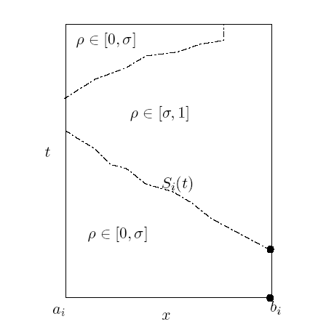
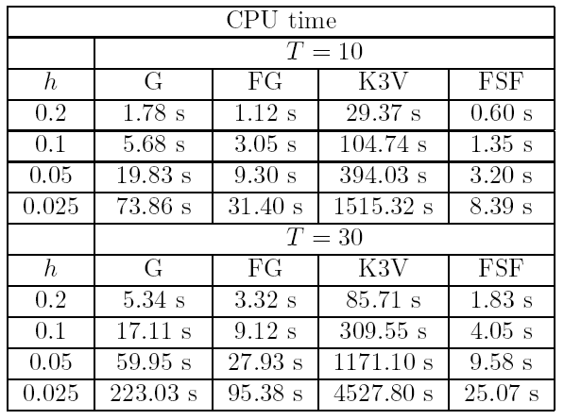
Full integration for applications
Network with 5000 roads parametrized by [0,1],
h space mesh size, T real time
1. Use simplified flux function with two characteristic speeds
f
2. Make use of theoretical results to bound the number of
regime changes
Free phase
Congested phase
G = Godunov, FG = Fast Godunov,
K3V = 3-velocities Kinetic, FSF = Fast Shock Fitting
3. Track exactly the regime change (generalized characteristic) and use upwind for each zone
ρ
Lemma. If we start from empty network, then each road presents at most
one regime change for every time
σ
ρ
max
Numerics on networks: Bretti, Garavello, Natalini, Cristiani, P., Herty, Klar, Goettlich, …

Slide 24
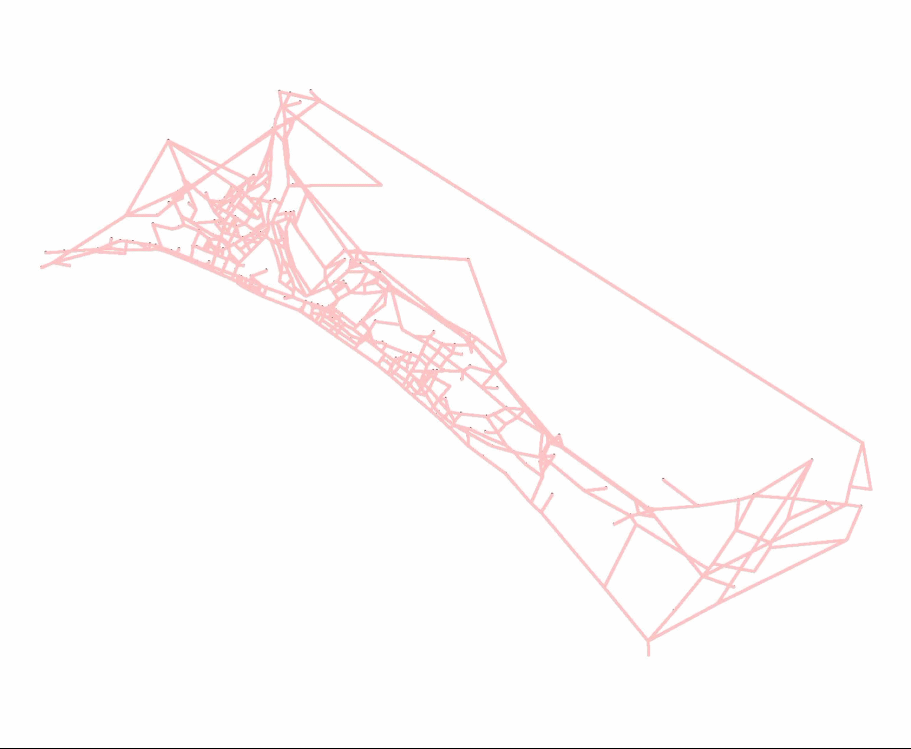
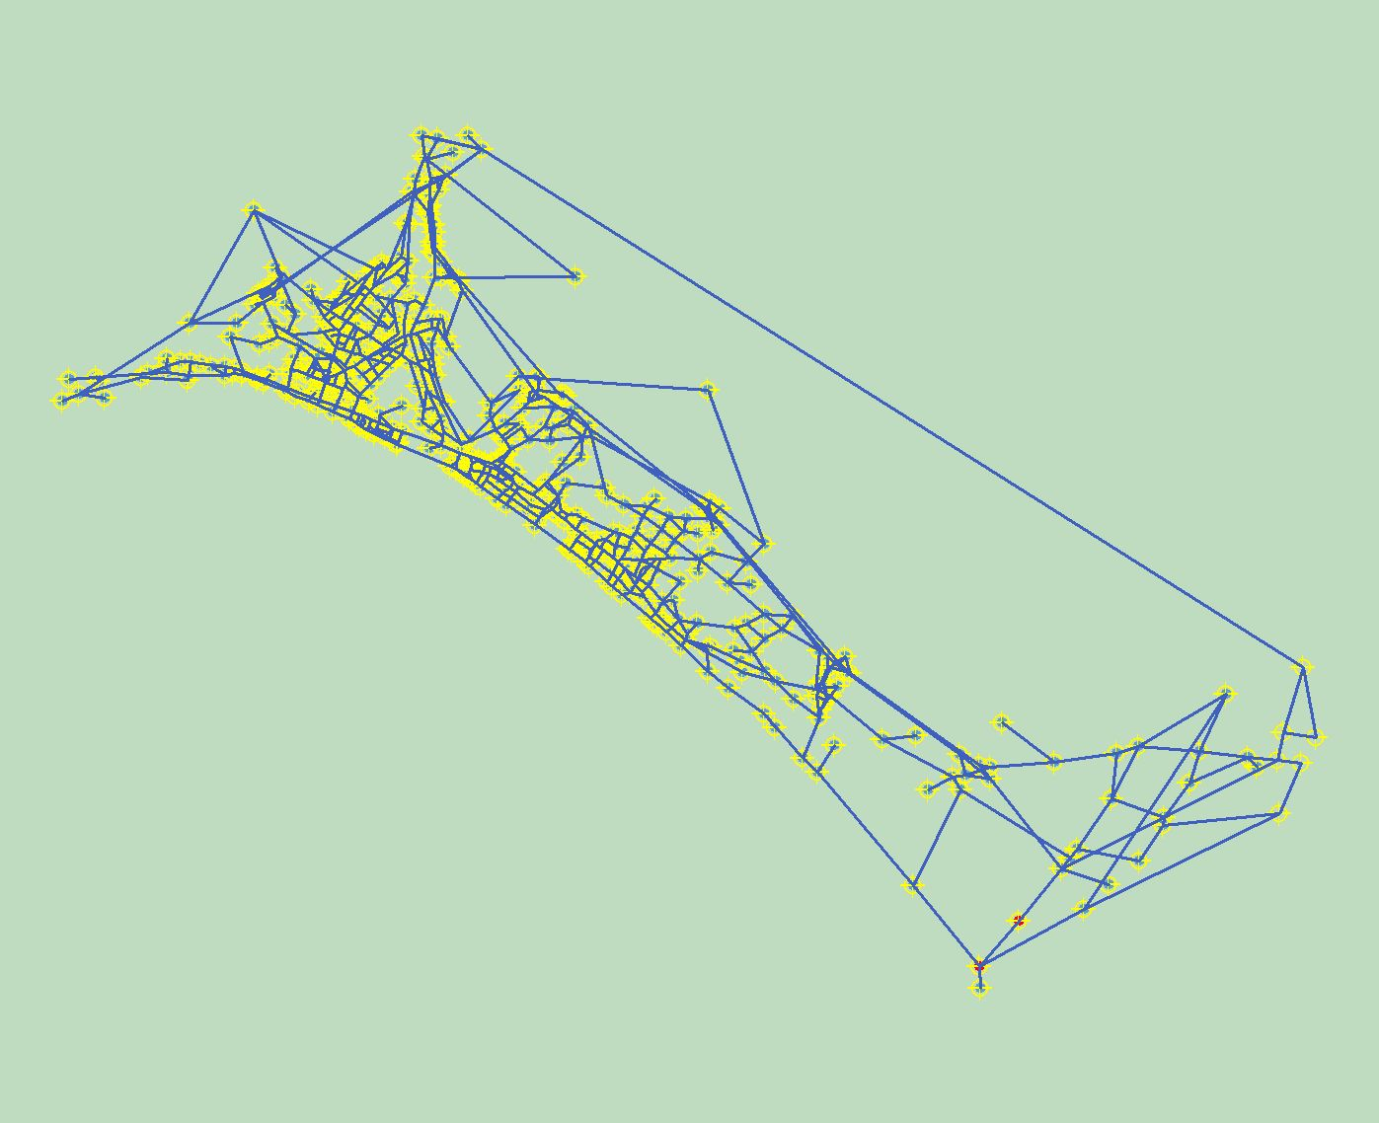
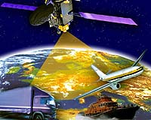
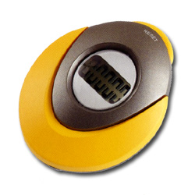
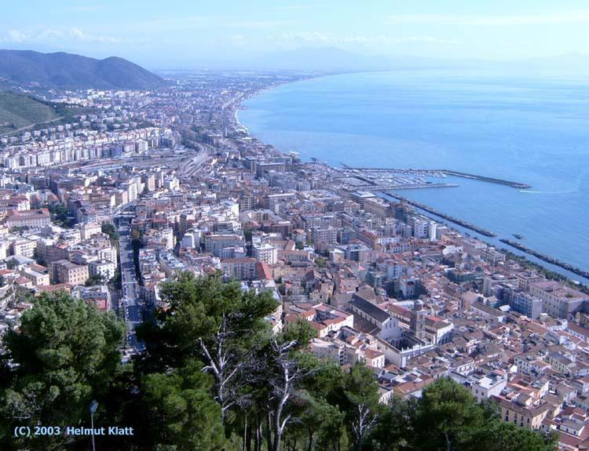
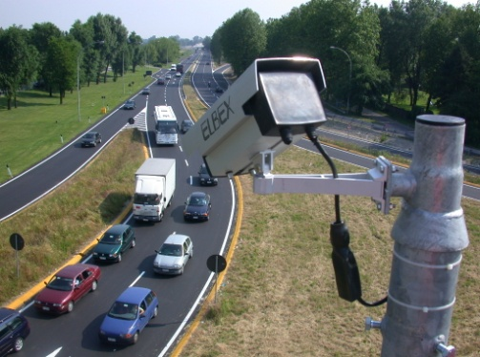
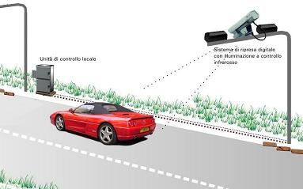
Real data
Problems :
Dimensionality: big networks
Data: measurements and elaboration
Manual counting
Satellite data
Radars
1500 arcs network
Plates reading
Videocameras
Simulations: Bretti, Sgalabro, D’Apice, Manzo, Cascone, Rarita’, Cutolo, P.
Notes:
24

Slide 25
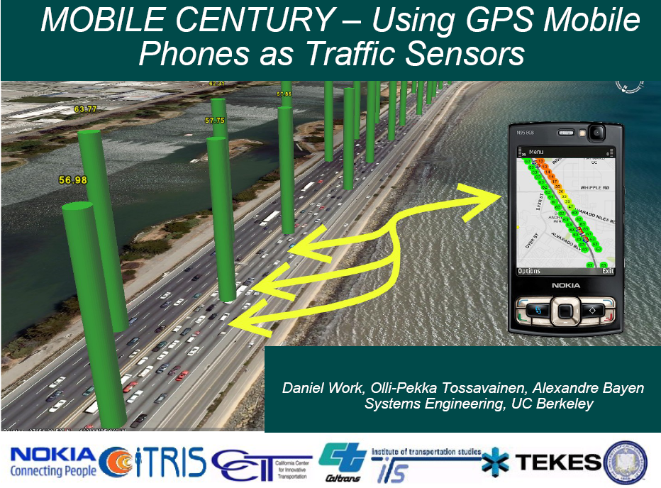
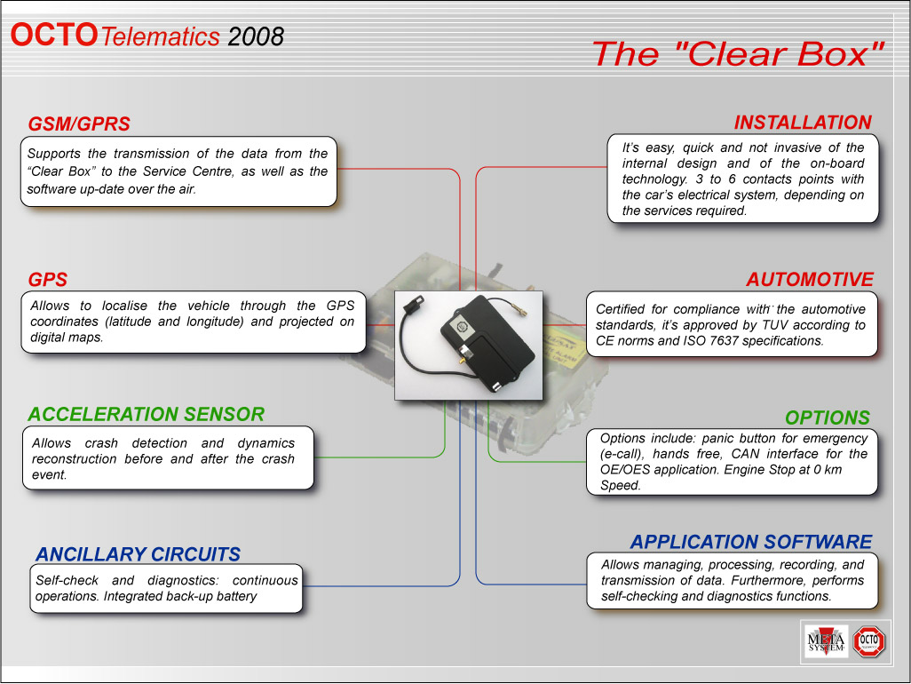
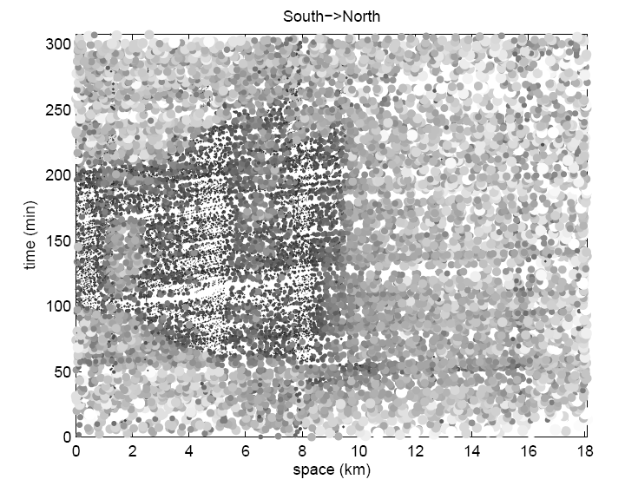
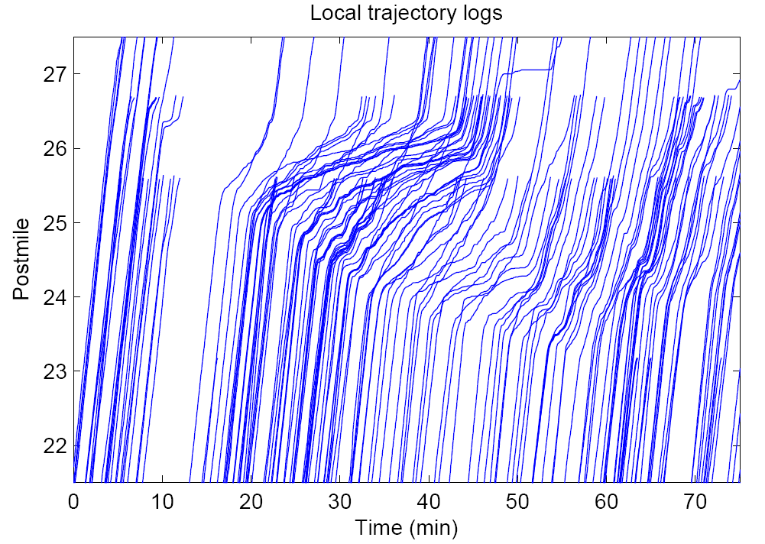
Berkeley-Nokia and Octotelematics
Berkeley-Nokia: Alex Bayen group, Octotelematics: Corrado DeFabritiis

Slide 26
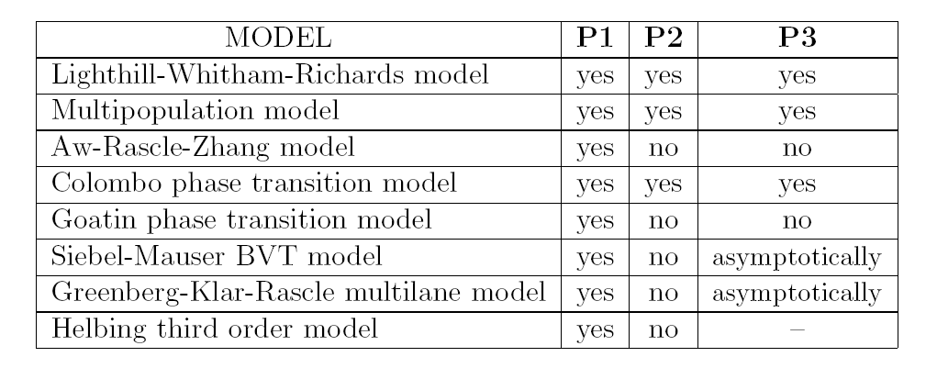

Red lights and jams
Are red lights and jams correctly modelled?
Red light or jam

Slide 27

A model fot T-junctions

