Slide 1
Intelligent groups and sparse controls:
Lecture 2
ITN – SADCO Summer school
"New Trends in Optimal Control”
Ravello, Italy, 3-7 September 2012

Slide 2
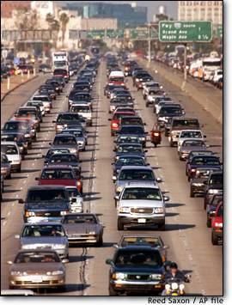
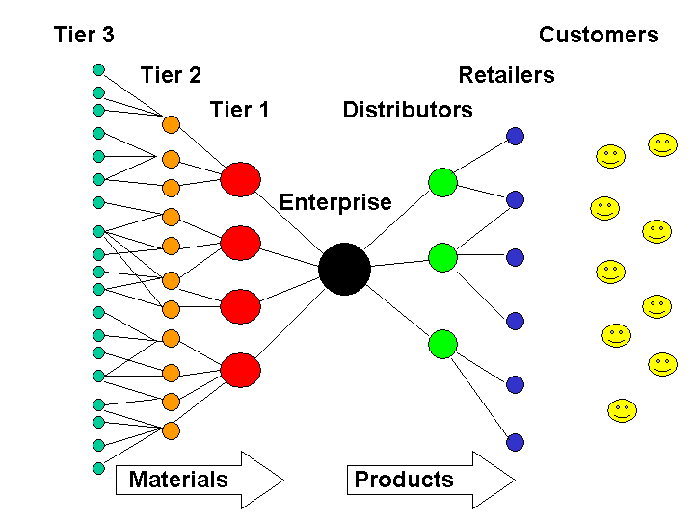
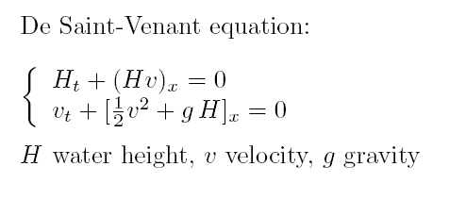
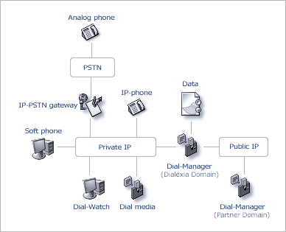
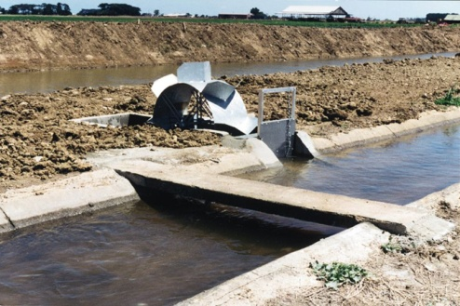
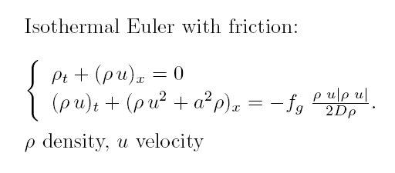
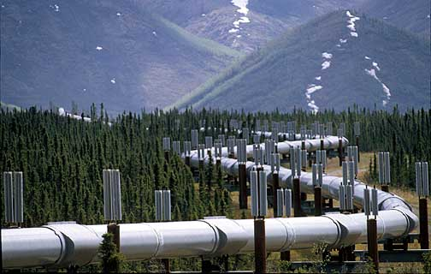
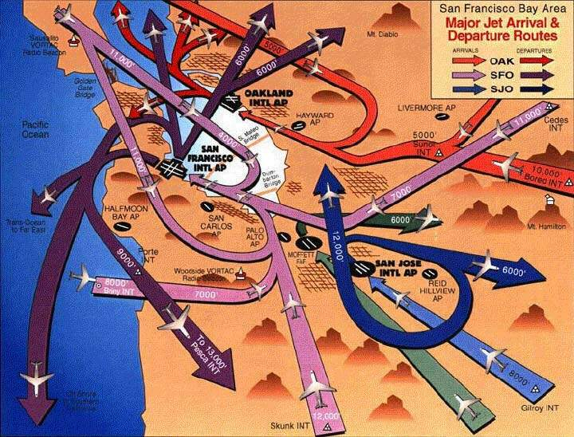
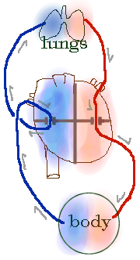
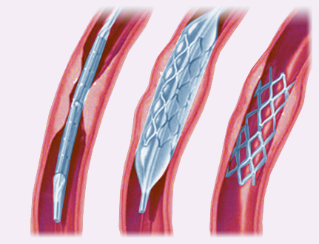
Transportation
Supply chains
Vehicular Traffic
Irrigation Channels
Services/Supply
Tlc and data networks
Gas pipelines
Air traffic management
Bio-Medical
Real fluids
Blood circulation
Vascular stents
Notes:
2

Slide 3


Model for data networks
First attempt
d
c
Second attempt
d
b
b
a

Slide 4



A conservation law for supply chains
(Armbruster, Degond, Ringhofer)
P1
P2
P3
Density of parts
Maximum processing capacity

Slide 5
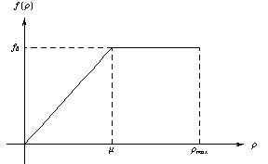
Flux function
Two different regimes: linear and constant,
depending on the density and processing capacity values.

Slide 6

Herty Klar model
q
Processor
The queue grows when
the difference among
incoming and outgoing
fluxes increases
The evolution of queues is determined by the flux, that has to be maximized on the outgoing arc.

Slide 7
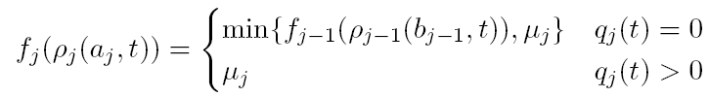
Processor with queue model (Goettlich-Herty-Klar)
Mixed ODE-PDE model
Queue
Processor j
Queue buffer occupancy change is given by
the difference between incoming and outgoing flux

Slide 8
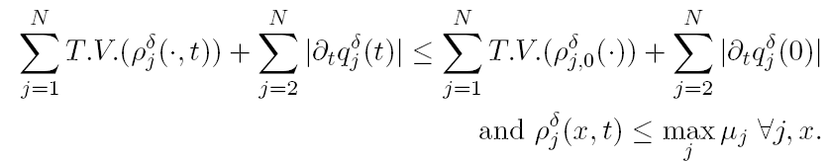
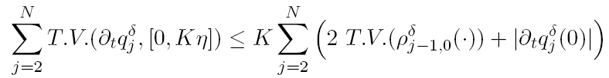
BV estimates for
Goettlich- Herty-Klar model

Slide 9
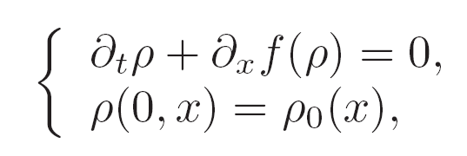
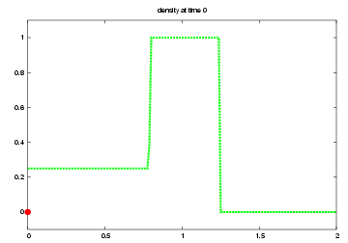
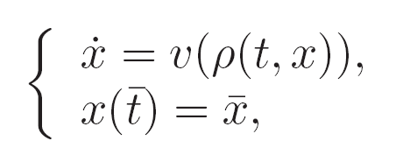
Car trajectory on network
Determine the trajectory of a car on a loaded network
Mixed ODE-PDE model
Theory: Colombo-Marson, Numerics: Bretti-P., Bretti-Cristiani-Lattanzio-Maurizi-P.,

Slide 10
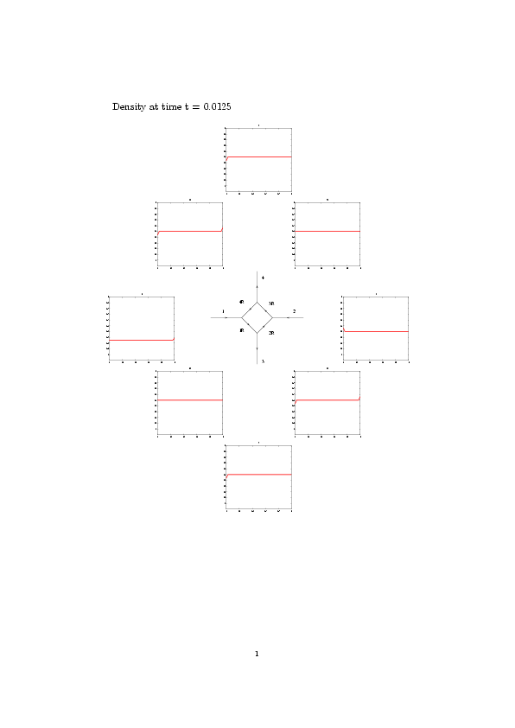
Simulation results

Slide 11
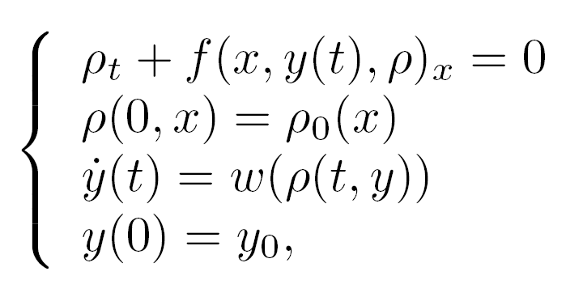
Full coupling: moving bottleneck
Convergence of fractional step algorithm
Pass to the limit using convergence in L^1 loc for densities
Pass to the limit using graph convergence for solutions to differential inclusions
and weak convergence of atomic part of derivatives

Slide 12
Finsler metric on L^1
L¹
Piecewise constant functions
u
u ∈ PC ⊂ L¹
v
ξ₂
Perturbations:
ξ₁
Δu_{i}
v
v
x₁
x₂
||(v, ξ)|| = ||v||_{L}1 + Σ|ξ_{i}| Δu_{i}
i

Slide 13
Finsler metric on L^1 (2)
u, u' ∈ PC
Family of piecewise smooth curves in PC connecting u and u':
: [0, 1] → PC
(0) = u, γ(1) = u'
L¹
γ₂
u'
γ₁
u
Define the length of each of these curves as
1
∫
L(γ) =
||(v, ξ)(s)|| ds
0
and the distance between u and u' (Finsler metric) as
d(u, u') = inf L(γ)
γ : u → u'
This metric is (compatible with) the usual L¹ metric, therefore it can be completed on the basis of the latter.

Slide 14
Lipschitz continuous dependence
u'(t)
u'(0)
(v, ξ)(0)
γ_{t}(s)
γ₀(s)
(v, ξ)(t)
u(0)
u(t)
Lemma:
||(v, ξ)(t)|| ≤ ||(v, ξ)(0)||
In view of this lemma one has:
d(u(t), u'(t)) = inf L(η)
≤ inf L(γ_{t})
η : u(t) → u'(t)
γ_{t} : u(t) → u'(t)
Lemma
≤ inf L(γ₀) = d(u(0), u'(0))
γ₀ : u(0) → u'(0)

Slide 15
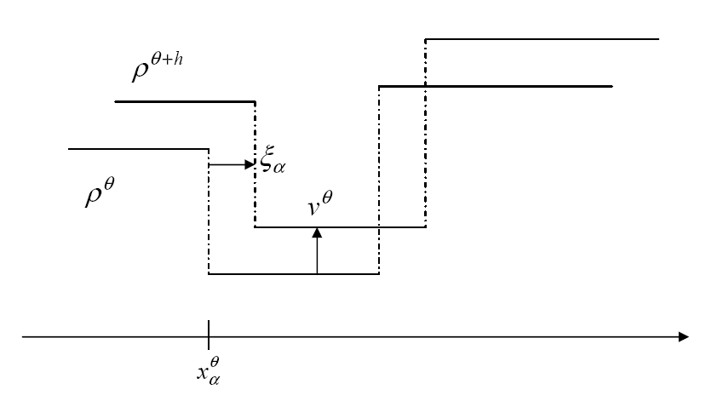
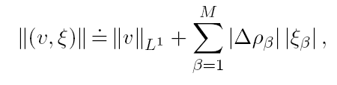

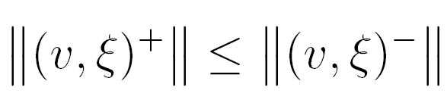



Lipschitz continuous dependence (tlc and GHK supply chain model)
Lemma (tlc)
Continuous dependence: Garavello-P., Herty-Klar-P.

Slide 16
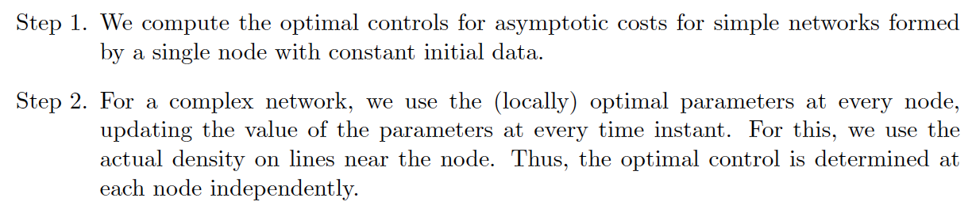
Optimization of network flow
Controls: distribution and priority parameters
Controls: inflows
Problem: for distribution/priority parameters no continuous dependence
Control of conservation laws: Ancona, Bressan, Coclite, Coron, Frankowska, etc.

Slide 17
1
3
Traffic distribution matrix A
2
4
Road 2
Road 4
Road 3
Road 1

Slide 18
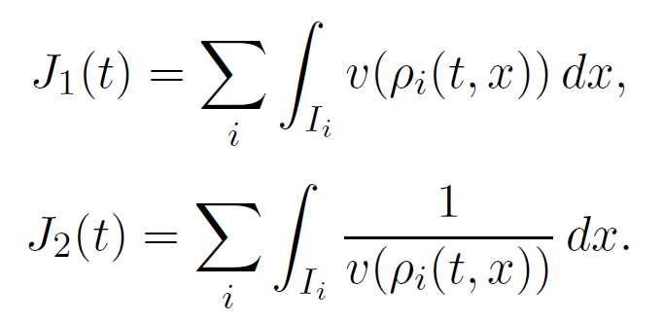
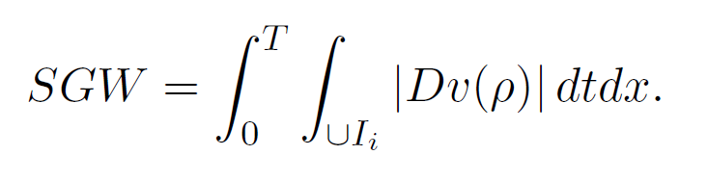
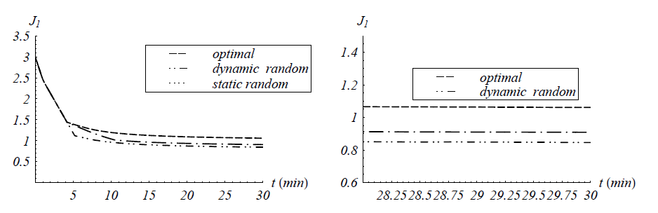
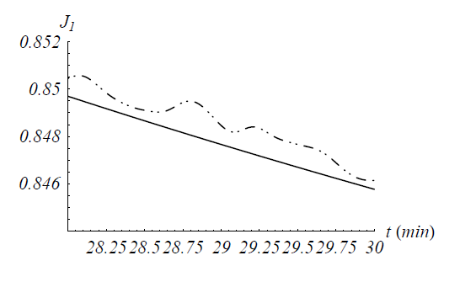
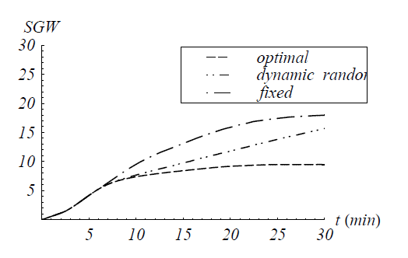
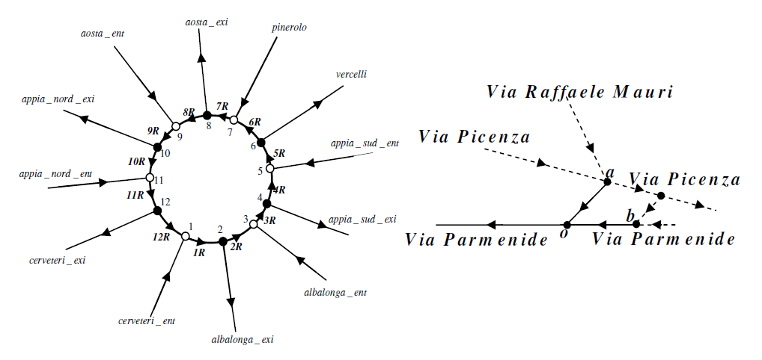
Optimization of vehicular traffic
Controls : distribution coefficients and right of way parameters

Slide 19
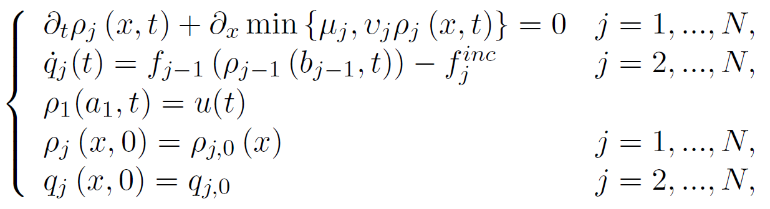
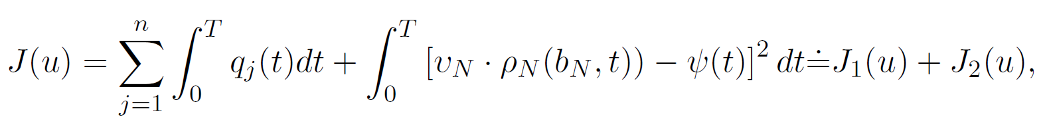
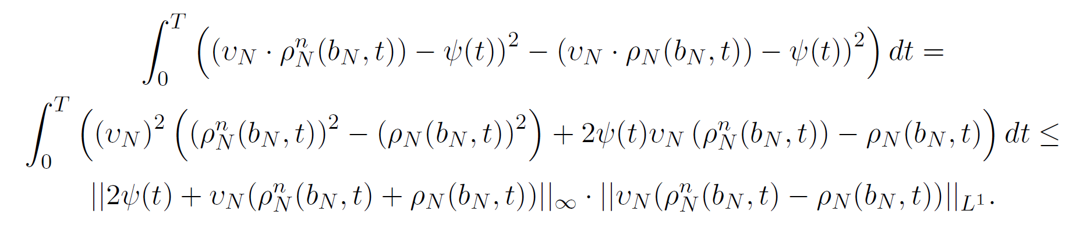
Optimal control for supply chains
Existence of solutions
Take minimizing sequence: compactness by Helly and Ascoli Arzela’ Theorem.

Slide 20
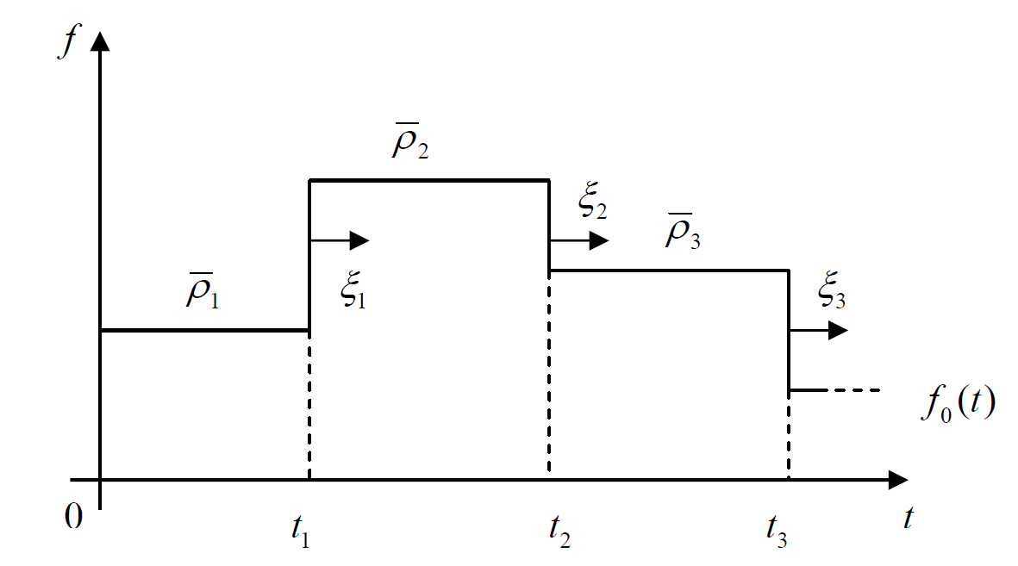
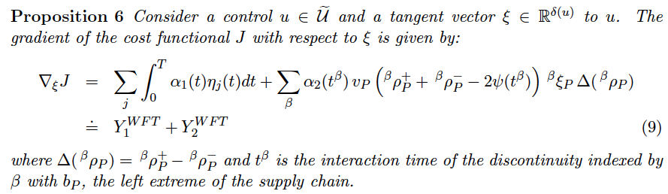
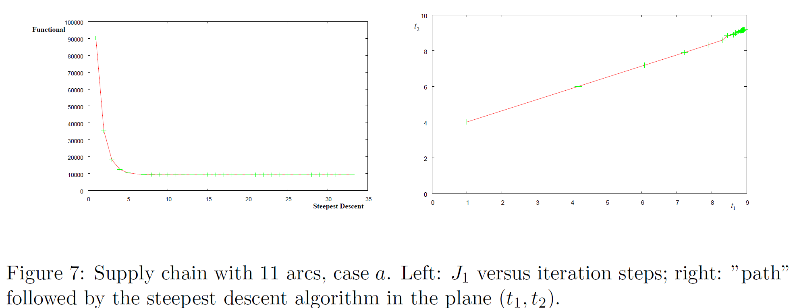
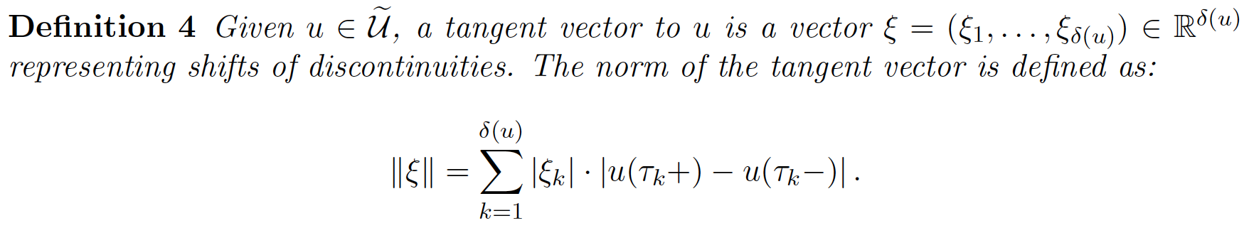
Tangent vectors for numerical optimization

Slide 21
Intelligent groups and sparse controls:
Lecture 3
ITN – SADCO Summer school
"New Trends in Optimal Control”
Ravello, Italy, 3-7 September 2012

Slide 22
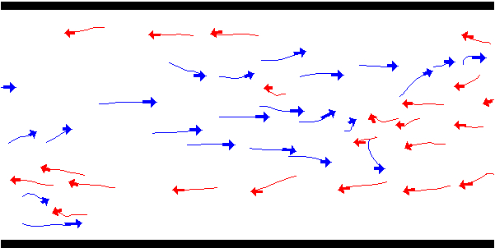

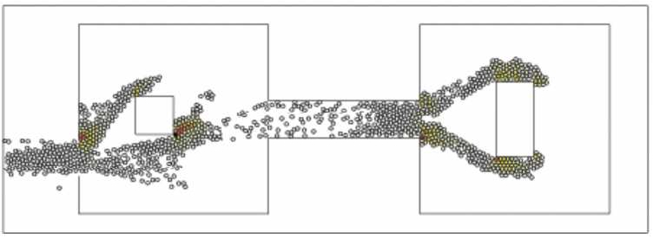
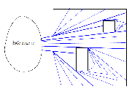


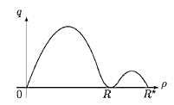
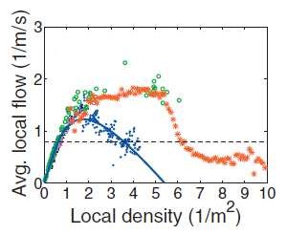
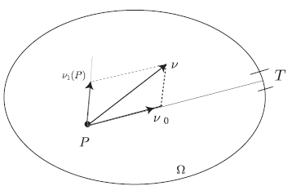
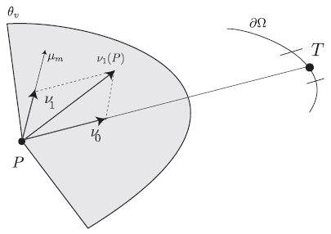


Tens, hundreds, thousands of pedestrians
Helbing et al., microscopic
Maury-Venel, microscopic
Colombo-Rosini, macroscopic 1D
Bellomo-Dogbé, macroscopic

Slide 23

Special Issue on:
MEAN FIELD GAMES
Volume 7 no. 2 June 2012
Guest Editors:
Fabio Camilli
Italo Capuzzo Dolcetta
Maurizio Falcone

Slide 24
New mathematical framework
Dirac deltas
Discrete points
MEASURES
Absolutely continuous measures
Continuous distribution
Simultaneous microscopic and macroscopic approach

Slide 25






Time evolving measures
Measure μ: (t,E) → μ(t,E) number of pedestrians in the region E
Flow map ɣ: x → x + v(x,μ) Δt move points with given velocity
At next time step is given by μ(t+Δt ,E) = μ(t,ɣ⁻¹ (E))
The velocity v is the sum of desired velocity v
d
and interaction term v (μ)
i
E
ɣ⁻¹ (E)
ɣ⁻¹
v
d
E
ɣ
v (μ)
i
Time evolving measares: Canuto-Fagnani-Tilli, Tosin-P., Muntean et al.,
Santambrogio, Carrillo-Figalli et al., Colombo, Gwiazda, Ambrosio-Ganbo ….

Slide 26
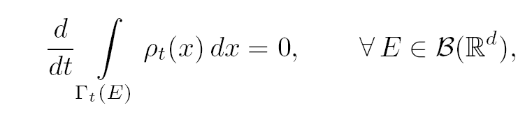


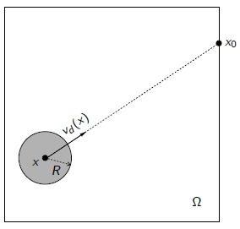
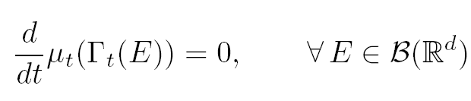



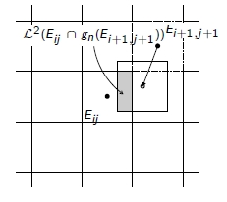


Time evolving measures
Walking area , e.g. Ω = [0, 1] x [0, 1]
Evolution of the system by push-forward of discrete-time measures:
The motion mapping ɣ_{n} has the form
for a velocity field given by the superposition of two effects:
The numerical scheme closely follows the idea of push-forward of the mass of pedestrians over a uniform square partition of the domain Ω:

Slide 27
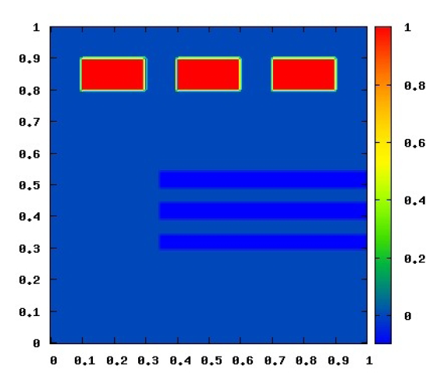
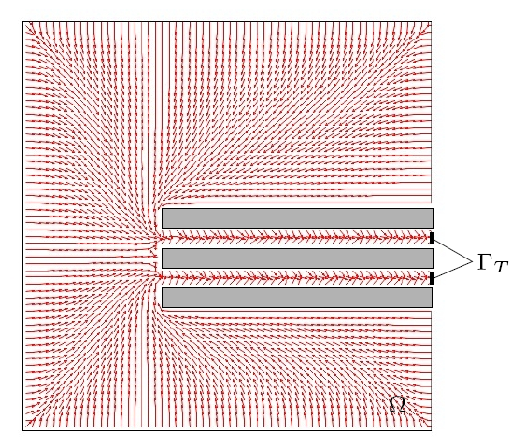
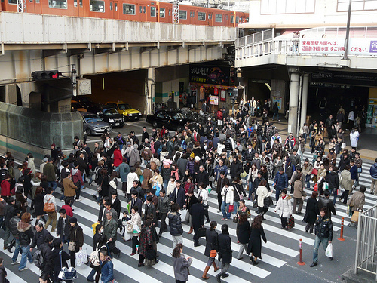

Macroscopic for self-organization in pedestrians
Initial condition
Desired velocity field
Exiting the metro: real movie
Exiting the metro: simulation
MICRO
MULTISCALE
MACRO

Slide 28



Integrated scales: doors & junctions
DOOR
JUNCTION
MACRO
MICRO
INTEGRATED SCALES

Slide 29
What metric for self-organization?

Slide 30
What metric for evolving measures?
ε
δ
If ε<δ then the L1 distance is O(1)

Slide 31






Wasserstein metric
d

Slide 32




Slide 33

Microscopic for animal groups
Coesion
Repulsion
Visual field
Logic variables activating the forces: discrete and continuous variables
Notes:
33

Slide 34






Microscopic for animal groups
R>>C, total vision
C>>R, front vision
C=R, front repulsion
Notes:
34

Slide 35


Beyond Consensus
Example: Cucker-Smale model
+u_{i}
Non-Flocking
Organization via intervention
Flocking

Slide 36
Beyond Consensus
A variational principle to sparse stabilization
Modulus of the velocities
Positions in the space
Control of Cucker-Smale: Caponigro, Fornasier, P., Trelat

Slide 37
Opinion Formation
Krause on the N-sphere
Equilibria
Rendez-vous
Antipodal
Polygonal

Slide 38
Opinion formation
Symmetric interaction
Equilibrium exponentially fast
Non-symmetric interaction
Periodic Orbits, Chaotic dynamics
External action:
Media, opinion leaders, influencers,
15 opinions
low action
150 opinions
low action
15 opinions
symmetric
150 opinions
symmetric
15 opinions
non-symmetric
Opinion formation: various, Caponigro-Lai-P.

Slide 39

























CROWD DYNAMICS
VEHICULAR TRAFFIC
SUPPLY CHAINS
SOCIAL
Simone Goettlich
Francesco Rossi
Mauro Garavello
Paola Goatin
Alessia Marigo
Andrea Tosin
Gabriella Bretti
Anna Chiara Lai
Roberto Natalini
Dirk Helbing
Dan Work
Ciro D’Apice
Michael Herty
Emiliano Cristiani
Seb Blandin
Alex Bayen
Corrado Lattanzio
Marco Caponigro
Rosanna Manzo
Giuseppe Coclite
Amelio Maurizi
Yacine Chitour
Paolo Frasca
Rinaldo Colombo
ANIMAL GROUPS
Axel Klar

