Slide 1
Mathematical and Computational Issues for Live Cell Segmentation in Fluorescence Microscopy
Metodi Matematici nel Trattamento delle Immagini
Sapienza Università di Roma
15-16 Gennaio 2013
Laura Antonelli
laura.antonelli@cnr.it
Institute for High Performance Computing and Networking (ICAR)

Slide 2
Research Context
FIRB 2010 project – “Future in Research” Programme
Role of Polycomb
mediated epigenetic signature in laminopathies:
analysis by innovative genome wide technology and
high-performance numerical algorithms
for Live Cell Imaging
CNR Insititutes involved
INMM
Institute of
Neurobiology and
Molecular Medicine
Institute for
High Performance Computing
and Networking
(Lanzuolo, Casalbore, Ciotti)
(Oliva, Antonelli, Gregoretti)
Notes:
Il ruolo delle modificazioni epigenetiche dipendenti dalle proteine Polycomb nelle laminopatie: uno studio con tecnologie innovative “genome wide” ed algoritmi numerici ad alte prestazioni per l’analisi di immagini

Slide 3
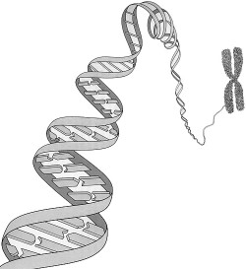
Laminopathies
Gene regulation is the process of turning genes on and off.
It is accomplished by a variety of mechanisms
including regulatory proteins like Polycomb group proteins.
cell
DNA
lamin
chromosome
nucleus
mutation
Laminopathies
are a group of rare
genetic disorders caused by mutations in genes encoding proteins of the nuclear lamin.
Notes:
Le laminopatie sono un gruppo di malattie genetiche causate da alterazioni (mutazioni=errori, una mutazione genera un malfunzionamento) della proteina nucleare lamina A/C e di alcune proteine correlate. Alcune laminopatie interessano selettivamente alcuni tessuti – laminopatie tessuto-specifiche Altre laminopatie causano difetti a carico di più tessuti – laminopatie sistemiche
Nella regolazione genica le proteine del gruppo Polycomb sono fattori transcrizionali, decidono cioé quanto RNA fare di un certo gene.
Laminopathies have a large variety of clinical symptoms including:
skeletal and/or cardiac muscular dystrophy, lipodystrophy
diabetes, dysplasia, dermo- or neuropathy, leukodystrophy, and progeria (premature aging).
Most of these symptoms develop after birth, typically during childhood or adolescence. Some laminopathies however may lead to an early death, and mutations of lamin B (LMNB1 gene) may be lethal before or at birth

Slide 4
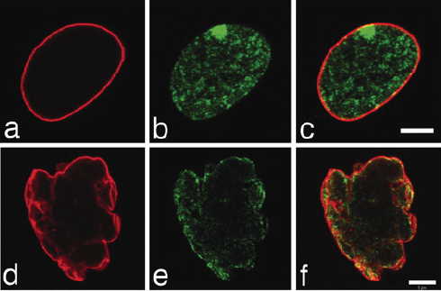
Role of Polycomb proteins in laminopathies
What is the involvement of lamin in the coordination of gene expression regulating sub-set of genes through direct or indirect interactions with Polycomb complexes ?
lamin
Polycombs
merge
Fluorescence images
highlight dramatically aberrant morphology
in cell nucleus
of progeria patients.
Normal
progeria syndrome
Identification of new candidate genes involved in laminopathies
Design of algorithms to identify and analyze lamin and polycombs
interaction in fluorescence images microscopy
Notes:
Dal punto di vista biologico, si ipotizza che la lamina coordini l’espressione genica regolando dei gruppi di geni attraverso interazioni dirette ed indirette con i complessi Polycomb.
Qui spiegare l’esperimento e la differenza tra le immagini verdi e rosse.
Since existing tools are limited in their scope and capacity to analyze hight-throuput live cell images,
significant challenges arise including segmentation, tracking and motion analysis

Slide 5
Fluorescence microscopy Issues
Huge amount of data
many image sequences
# frames per sequence: from 60 to 120
single frame size: 1024 x 1280
Manual analysis to extract information by means of large volume of light microscopy images is slow, time consuming
and subject to observer variance
Features of Fluorescence images
The variety of fluorescent proteins and labeling techniques leads to considerable differences in the appearance of cells
Since cells are sensible to photodamage, fluorescence microscopies produce images with very low contrast
Fluorescence images may contain autofluorescence
Existing imaging tools are limited in their scope and capacity to analyze live cell images
Notes:
Automated, high-throughput microscopy can be considered as consisting of six modules:
biological experiments and image acquisition
Image processing and analysis
Quantitative feature extraction and database storage
Validation
Data modeling and statistical analysis
Visualization
Current imaging tools such as Image/J or CellProfiler, while reasonably satisfactory for standard image processing, are extremely limited in their scope and capacity for HTS image data analysis, particularly with respect to complex shape or multispectral and temporal correlations.

Slide 6
Goals
Work in progress
2013 - 2015
Development of an open source library
for live cell imaging in
high performance computing environment
Visualizing and Analysis
Visualizing, quantifying and modelling cellular and sub-cellular morphological features with high spatial and temporal resolution
Preprocessing/Postprocessing
denoising, deblurring, scaling, contrast enhancement, features extraction
Processing
segmentation ➔ “easy” description of cell images
➔ features extraction
tracking ➔ temporal analysis of dynamic cellular processes

Slide 7
Cell Segmentation Models and Methods
The kind of features to be highlighted is directly related to the biological experiment, therefore the choice of the model is fundamental in order to produce a correct segmentation.
microscopy images features:
smooth boundaries
two phase images: regions of interest and background
presence of noise
Active Contours Models
model image contours as curves that match the highest gradient
edge detector based on image gradient
edge detector NOT based on image gradient
Region Based Models
provide a simplified image as a combination of regions of costant intensities:
Mumford and Shah approach
Global tresholding
watershed algorithm
Notes:
Any gray tone image can be considered as a topographic surface. If we flood this surface from its minima and, if we prevent the merging of the waters coming from different sources, we partition the image into two different sets: The catchment basins and the watershed lines. If we apply the watershed transformation to the image gradient, the catchment basins should theoretically correspond to the homogeneous gray leve regions of this image.
However, in practice, this transform produces an important over-segmentation due to noise or local irregularities in the gradient image
Ogni immagine di tono grigio può essere considerato come un superficie topografica. Se ci allagare questa superficie dal suo minimi e, se impediamo alla fusione delle acque provenienti da fonti diverse, abbiamo l'immagine di partizione in due diverse serie: I bacini idrografici e le rispettive linee spartiacque. Se applichiamo lo spartiacque trasformazione al gradiente dell'immagine, del bacino bacini teoricamente dovrebbe corrispondere alla omogenei regioni di livello di grigio di questa immagine.
Tuttavia, in pratica, questa trasformazione produce importante eccessiva segmentazione a causa di disturbi o locale irregolarità dell'immagine gradiente

Slide 8
Active Contour Models
bounded open set with boundary ∂Ω
given image
parameterized curve
Kass, Witkin, Terzopoulus,
“Snakes: Active Contour Models”, Int. J. Comput. Vis.
Classical Model
Chan, Vese,
“ Active Contour Without Edges”, IEEE Trans. on Im. Proc.
Chan-Vese Model
Notes:
In the classical model an edge-detector is used, depending on the gradient of the image u₀, to stop evolving curve on the boundary of the desired object. These models can detect only objects with edges defined by gradient and are suitable for images without noise.
Chan-Vese model finds a contour C that partitions the image u0 into two regions: Ωin (objects) and Ωout (background)
that describe an optimal piecewise constant approximation of the image.

Slide 9
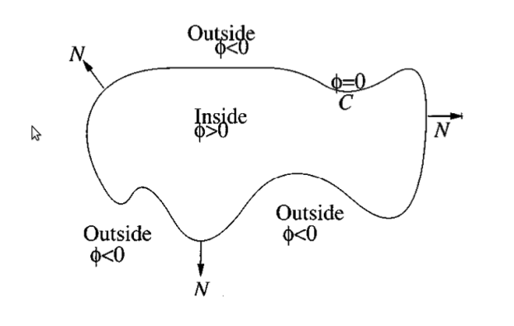
AC Chan-Vese Level Set Formulation
Sethian,
“ Level Set Methods and Fast Marching Methods”
The paramaterized curve
C ⊂ Ω is represented by the zero level set of a Lipschtz function φ :Ω →ℜ
Keeping φ fixed, we can compute c₁ and c₂ as function of φ
Notes:
Recall ω⊂Ω is open, and C=∂ω. In figure we illustrate the above assumptions and notations on the level set function φ

Slide 10
Regularization
We determine φ by means the gradient-descent method and Euler-Lagrange equations
Regularized function
Since the functional is non-convex, the use of regularized functions can drive the Euler-Lagrange equation towards the global minimizer
Euler-Lagrange equation
Notes:
Recall ω⊂Ω is open, and C=∂ω. In figure we illustrate the above assumptions and notations on the level set function φ
Using regularized H can drive the Euler-Lagrange equation towards the global minimizer

Slide 11
Numerical Algorithm
Chan-Vese Segmentation
Inizialize φ ⁰
for n = 1,2, …, N_{max}
compute c₁(φ ^{n}) and c₂(φ ^{n})
compute φ ^{n+1} solving EL equation
reinitialize φ ^{n+1} to the signed distance function
Check wether solution is stationary.
If yes, stop iterations
The reinitialization process is made by using the following PDE:

Slide 12
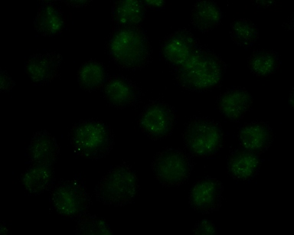
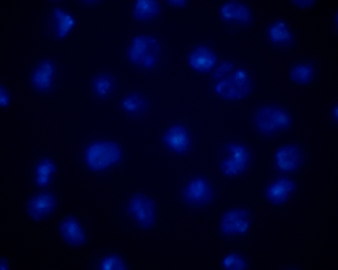
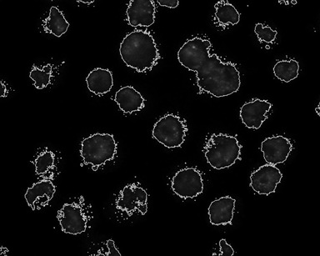
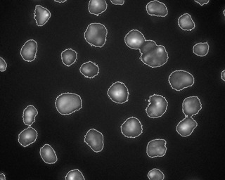
test 1: fluorescence image segmentation
1/3
Mouse embryonic
stem cells
Analysis of the lamin role in PcG mediated muscle and neuronal cell differentiation
Polycombs
DNA
Image size
1024 X 1280
touching cells not separated!
Notes:
le cellule in coltura vengono prima fissate sul vetro e poi trattate con coloranti specifici che evidenziano particolari strutture nucleari. Nello specifico è stato usato il dapi che legandosi al DNA evidenzia le varie zone con DNA addensato (e mostri i puntini azzurri). Inoltre è stato utilizzato un anticorpo che riconosce la proteina di interesse, ovvero i Polycomb, e che porta un fluorocromo verde, quindi il colore verde indica la presenza di questa proteina. In entrambi i casi la fluorescenza viene visualizzata al microscopio mediante lampade (che fanno parte del microscopio a fluorenscenza) che emettono in uno specifico spettro.

Slide 13
test 1: fluorescence image segmentation
2/3
Model Parameters
Architecture
λ₁ | λ₂ | μ | iteration | Time (SEC)
0.9 | 1 | 0.5 | 130 | 48
0.9 | 1 | 0.5 | 310 | 127
CPU Intel I5 750
@2.67GHz (quad-core)
MEMORY 4GB
gcc version 4.7.1
OS debian wheezy
Image library libtiff
Polycombs
DNA
Polycombs
DNA
Image size
1024 X 1280
Notes:
le cellule in coltura vengono prima fissate sul vetro e poi trattate con coloranti specifici che evidenziano particolari strutture nucleari. Nello specifico è stato usato il dapi che legandosi al DNA evidenzia le varie zone con DNA addensato (e mostri i puntini azzurri). Inoltre è stato utilizzato un anticorpo che riconosce la proteina di interesse, ovvero i Polycomb, e che porta un fluorocromo verde, quindi il colore verde indica la presenza di questa proteina. In entrambi i casi la fluorescenza viene visualizzata al microscopio mediante lampade (che fanno parte del microscopio a fluorenscenza) che emettono in uno specifico spettro.

Slide 14
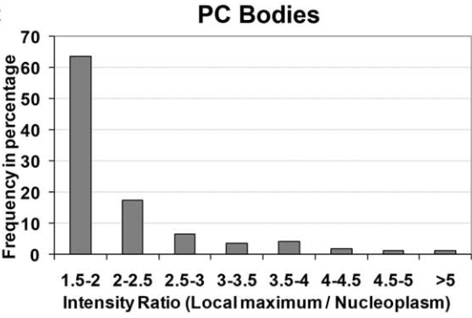
test 1: fluorescence image segmentation
3/3
Model Parameters
Architecture
λ₁ | λ₂ | μ | iteration | Time (SEC)
0.9 | 1 | 0.5 | 130 | 48
0.9 | 1 | 0.5 | 310 | 127
CPU Intel I5 750
@2.67GHz (quad-core)
MEMORY 4GB
gcc version 4.7.1
OS debian wheezy
Image library libtiff
Polycombs
DNA
Polycombs
Features extraction
Notes:
le cellule in coltura vengono prima fissate sul vetro e poi trattate con coloranti specifici che evidenziano particolari strutture nucleari. Nello specifico è stato usato il dapi che legandosi al DNA evidenzia le varie zone con DNA addensato (e mostri i puntini azzurri). Inoltre è stato utilizzato un anticorpo che riconosce la proteina di interesse, ovvero i Polycomb, e che porta un fluorocromo verde, quindi il colore verde indica la presenza di questa proteina. In entrambi i casi la fluorescenza viene visualizzata al microscopio mediante lampade (che fanno parte del microscopio a fluorenscenza) che emettono in uno specifico spettro.

Slide 15
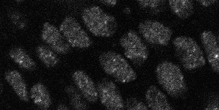
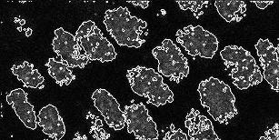
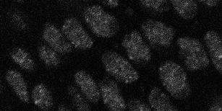
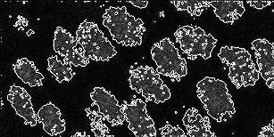
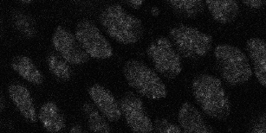
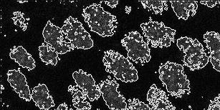
test 2: time-lapse segmentation
Model Parameters
frame | λ₁ | λ₂ | μ | iteration | Time (SEC)
1 | 1.2 | 0.9 | 0.5 | 227 | 32
31 | 1.2 | 0.9 | 0.5 | 221 | 38
61 | 1.2 | 0.9 | 0.5 | 228 | 43
Mouse embryonic stem cells,
Noised images
512 X 256
frame 1
segmentation
frame 31
frame 61
Very smooth boundaries!
Notes:
La segmentazione riesce a separare nettamente tutte le cellule dal background.
Tale separazione ci consente di estrarre tutte le informazioni sulle regioni selezionate, ovvero quello di interesse.

Slide 16
test 3: image sequence tracking
Chan-Vese Tracking algorithm
Inizialize φ ⁰
for k = 1,2, …, N_{frames}
for n = 1,2, …, N_{max}
compute c₁(φ ^{n}) and c₂(φ ^{n})
compute φ ^{n+1} solving EL equation
reinitialize φ ^{n+1} to the signed distance function
Check wether solution is stationary. If yes, stop iterations of n counter
Initialize φ ^{k+1} =φ ^{k}
Architecture
CPU Intel I5 750
@2.67GHz
(quad-core)
MEMORY 4GB
gcc version 4.7.1
OS debian wheezy
Image library libtiff
Mouse embryonic stem cells
Time lapse image sequence
512 X 256 X 61 frame
Time (min)
17

Slide 17
Model and Algorithm Evaluation
Advantages
good segmentation cell images with very smooth boundaries
robustness with respect noise
scale adaptivity
semplicity of implementation
low computational cost of a single iteration
Drawbacks
lack of convexity (presence of local minima)
dependence on initial contour position
high computational cost for step reinizialization of level set
bad segmentation for images with intensity inhomogeneity
tounching cells not separated
slow convergence rate (too many iterations for tracking!)
possible trapping in local minimum

Slide 18
Improving the model
Work in progress
Extending multi-phase segmentation
L. Vese, T. Chan
“A Multiphase Level Set Framework for Image Segmentation Using the Mumford an Shah Model”
Work in progress
Introducing local statistical information
X.F Wang, D. Huang, H. Xu
“An Efficient local Chan-Vese model for image segmentation”
Notes:
By subtracting the original image from averaging convolution image segmentation enforces the contrast between foreground and background

Slide 19
Improving the solution method
Approach the problem from the optimization
point of view
Work in progress
In collaboration with D. di Serafino and V. De Simone,
Second University of Naples.
Faster gradient-descent approaches (non-monotone methods, exploitation of geometric properties of the variational model, …)
Newton-type methods, using approximations of the second variation
- efficient iterative linear algebra techniques
globalization techniques (line search or trust region)
Optimization methods for L1-regularized Chan-Vese model (split Bregman, alternate direction of multipliers)

Slide 20
Speeding-up the implementation
Work in progress
Introducing Data Parallelism in tracking algorithm
Inizialize φ ⁰
for k = 1,2, …, N_{frames}
for n = 1,2, …, N_{max}
compute c₁(φ ^{n}) and c₂(φ ^{n})
compute φ ^{n+1} solving EL equation
Reinitialize φ ^{n+1} to the signed distance function
Check wether solution is stationary. If yes, stop iterations of n counter
Initialize φ ^{k+1} =φ ^{k}
Frames distribution between processes

Slide 21
Acknowledgments
Dr C. Lanzuolo at INMM-CNR for fruitful discussion on biological experiments and for providing fluorescence images of mouse embryonic stem cells
Dr. G. Cavalli at Institute of Human Genetic–CNRS (France) for providing time-lapse sequences of Mouse embryonic stem cells
Thanks for your attention
any comments and suggestions
are welcome !
laura.antonelli@cnr.it

Slide 22
Goals of FIRB Project
A large scale approach
INMM APPROACH ➔ High-Throughput Screening (HTS):
The generation of 4C libraries of lamin dependent gene interactions
Identification of new candidate genes involved in laminopathies that could be useful for prognosis
Investigation of the molecular basis of the disease to eventually design new therapeutical strategies
ICAR APPROACH ➔ High-Throughput Bioimaging (HBS):
Identification of epigenetic dynamics associated with lamin pathology
Design algorithms to identify and analyze biological processes
Development of an open source numerical library for live cell imaging

Slide 23
Active Contour Chan-Vese Model
Chan, Vese,
“ Active Contour Without Edges”, IEEE Trans. on Im. Proc.
Let be:
Ω a bounded open set of , with ∂Ω its boundary
a given image
a parameterized curve
Chan-Vese model finds a contour C that partitions the image u₀ into two regions: Ω_{in} (objects) and Ω_{out} (background)
that describe an optimal piecewise constant
approximation of the image.
Internal force
External forces
Notes:
Specifically, the method finds a contour C that minimizes the following segmentation energy where c_in and c_out represent the average intensities in the regions : Ω_{in} and Ω_{out} respectively, and where lambda1 and lambda2 are fixed parameters.

Slide 24
Euler-Lagrange Regularized Equations
Keeping φ fixed, we can compute
Regularized function
Notes:
Recall ω⊂Ω is open, and C=∂ω. In figure we illustrate the above assumptions and notations on the level set function φ
Using regularized H can drive the Euler-Lagrange equation towards the global minimizer

Slide 25
Discretization
Euler-Lagrange equation is discretized
by means a finite differences semi-implicit scheme.
Discrete divergence operator
Rudin, Osher, Fatemi,
“ Non Linear Total Variation Based Noise Removal Algorithm”

