Slide 1
A Geometric Approach to Matrix Completion
Alex Bronstein, CS@Technion
Joint work with Amit Boyarski & Sanketh Vedula

Slide 2




Matrix completion
Column space: items
Incomplete measurements
$$m_{ij} :\left(i,j\right)∈𝒮$$
Row space: users
Goal: estimate full matrix $X$
such that
$$m_{ij}$$
$$X⨀S=M⨀S$$

Slide 3


Matrix completion
Column space: items
$$\min_{X}{{ \left\|\left(X−M\right)⨀S\right\|}_{F}^{2}}$$
$$+prior(X)$$
Problem is under-determined!
Row space: users

Slide 4

Rank-regularized matrix completion
Column space: items
$$\min_{X}{{ \left\|\left(X−M\right)⨀S\right\|}_{F}^{2}}$$
$+ rank(X)$
Problem: rank is intractable!
Row space: users

Slide 5





Rank-regularized matrix completion
$$\min_{X}{{ \left\|\left(X−M\right)⨀S\right\|}_{F}^{2}}+μ rank(X)$$
Convex relaxation
Factorized form
$$\min_{X}{{ \left\|\left(X−M\right)⨀S\right\|}_{F}^{2}}+μ {\left\|X\right\|}_{∗}$$
$$\min_{Y, Z^{T}}{{ \left\|\left(YZ^{T}−M\right)⨀S\right\|}_{F}^{2}}$$
$${\left\|X\right\|}_{∗}=σ_{1}+⋯+σ_{n}$$
Deep matrix factorization (DMF)
$$\min_{Y_{1},…,Y_{k}}{{ \left\|\left(Y_{1}⋅⋯⋅Y_{k}−M\right)⨀S\right\|}_{F}^{2}}$$
Candes & Recht, 2009
⋅ Gunasekar et al., 2017 ⋅ Arora et al., 2019

Slide 6



Deep matrix factorization (DMF)
$$\min_{Y_{1},…,Y_{k}}{{ \left\|\left(Y_{1}⋅⋯⋅Y_{k}−M\right)⨀S\right\|}_{F}^{2}}$$
Overparametrized representation
Gradient descent dynamics promote implicit rank regularization
The effect is stronger with depth $k$
$$\dot{σ_{i}}\left(t\right)∝−k{⋅\left(σ_{i}^{2}(t)\right)}^{1−1/k}$$
Gunasekar et al., 2017 ⋅ Arora et al., 2019

Slide 7





Geometric matrix completion
Column graph $𝒢_{c}$
Matrix $X$ lives on the product
graph $𝒢=𝒢_{r}⊠𝒢_{c}$
Prior: $X$ is band-limited on $𝒢$
Row graph $𝒢_{r}$
Assume $𝒢_{r}$ and $𝒢_{c}$are known
Kalofolias et al., 2014 ⋅ Monti et al., 2017

Slide 8










Graph Laplacian
Row graph $𝒢_{r}$
Column graph $𝒢_{c}$
$A_{r}$ (weighed) adjacency matrix
$A_{c}$ (weighed) adjacency matrix
$D_{r}$ (weighed) degree matrix
$D_{c}$ (weighed) degree matrix
$L_{r}=D_{r}−A_{r}$ graph Laplacian
$L_{c}=D_{c}−A_{c}$ graph Laplacian
$$L=L_{r}⨁L_{c}$$
Laplacian of product graph $𝒢=𝒢_{r}⊠𝒢_{c}$

Slide 9


Dirichlet energy
Prior: matrix $X$ is band-limited on $𝒢=𝒢_{r}⊠𝒢_{c}$
$$E\left(X\right)={\left\langle X,L_{r}⨁L_{c}X\right\rangle }_{𝒢}$$
Dirichlet energy
$$=tr\left(X^{T}L_{r}X\right)+tr\left({XL}_{c}X^{T}\right)$$
$$\min_{X}{{ \left\|\left(X−M\right)⨀S\right\|}_{F}^{2}}+μ_{r} tr\left(X^{T}L_{r}X\right)+μ_{c} tr\left({XL}_{c}X^{T}\right)$$

Slide 10





Spectral parametrization
Orthogonal eigendecomposition
$L_{r}=ΦΛ_{r}Φ^{T}$
$L_{c}=ΨΛ_{c}Ψ^{T}$
$$X=ΦCΨ^{T}$$
$$E=tr\left(X^{T}L_{r}X\right)+tr\left({XL}_{c}X^{T}\right)$$
$$=tr\left(ΨC^{T}Φ^{T}L_{r}ΦCΨ^{T}\right)+tr\left({ΦCΨ^{T}L}_{c}ΨC^{T}Φ^{T}\right)$$
$$=tr\left(C^{T}Λ_{r}C\right)+tr\left({CΛ}_{c}C^{T}\right)$$

Slide 11



Spectral geometric matrix completion (SGMC)
$$\min_{C}{{ \left\|\left(ΦCΨ^{T}−M\right)⨀S\right\|}_{F}^{2}}+μ_{r} tr\left(C^{T}Λ_{r}C\right)+μ_{c} tr\left({CΛ}_{c}C^{T}\right)$$
We assumed $𝒢_{r}$ and $𝒢_{c}$known
Learn modified bases
$Φ′=ΦP$
$Ψ^{′}=ΨQ$
Kovnatsky et al., 2013 ⋅ Litany et al., 2017

Slide 12





Spectral geometric matrix completion (SGMC)
$$\min_{C,P,Q}{{ \left\|\left(ΦPCQ^{T}Ψ^{T}−M\right)⨀S\right\|}_{F}^{2}}$$
$$+ μ_{r} tr\left(QC^{T}P^{T}Λ_{r}PCQ^{T}\right)$$
smoothness
$$+ μ_{c} tr\left({PCQ^{T}Λ}_{c}QC^{T}P^{T}\right)$$
$$+ o_{r}{ \left\|P^{T}P−I\right\|}_{F}^{2} +o_{c}{ \left\|Q^{T}Q−I\right\|}_{F}^{2}$$
orthogonality
$$+ ρ_{r}{ \left\|off\left(P^{T}Λ_{r}P\right)\right\|}_{F}^{2} +ρ_{c}{ \left\|off\left(Q^{T}Λ_{c}Q\right)\right\|}_{F}^{2}$$
approximate
diagonalization
SGMC = a form of DMF + geometric regularization

Slide 13
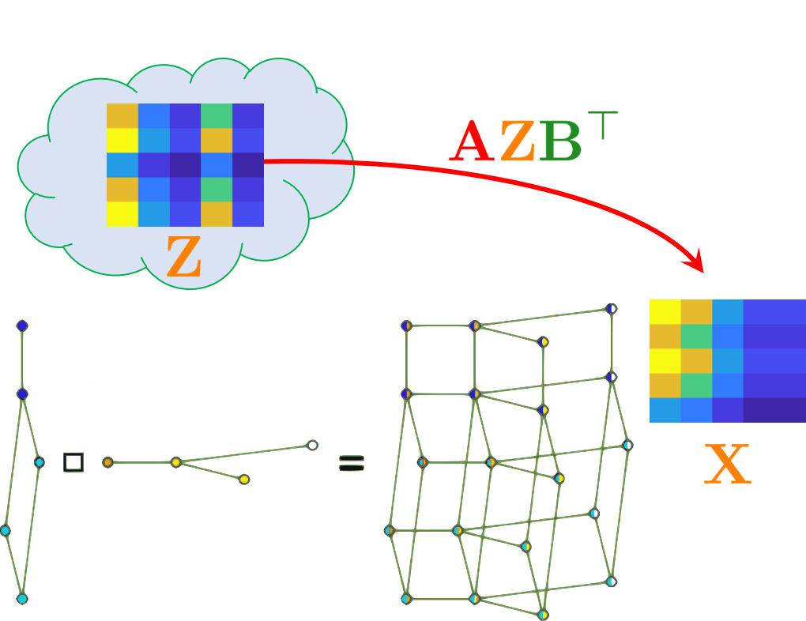


Geometric Interpretation
Example:
If $𝒢^{′}≅ 𝒢$
$$X=Π_{1}ZΠ_{2}^{T}$$

Slide 14

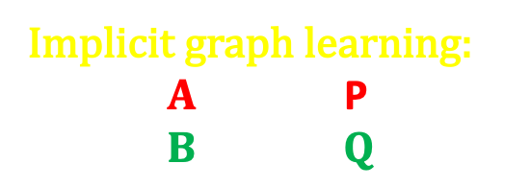

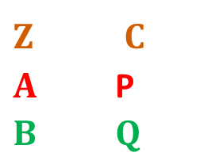

Orthogonal eigendecomposition
Implicit graph learning:
$$AΦ^{′}=Φ\text{P} \\ BΨ^{′}=ΨQ$$
$$L_{r}=ΦΛ_{r}Φ^{T} \\ L_{r}^{′}=Φ^{′}Λ_{r}^{′}{Φ^{′}}^{T}$$
$$L_{c}=ΨΛ_{c}Ψ^{T} \\ L_{c}^{′}=Ψ^{′}Λ_{c}^{′}{Ψ^{′}}^{T}$$
$$Z=Φ^{′}C{Ψ^{′}}^{T} \\ A=Φ\text{P}{Φ^{′}}^{T} \\ B=ΨQ{Ψ^{′}}^{T}$$
$$X=AZB^{T}\text{=}Φ\text{P}CQ^{T}Ψ^{T}$$

Slide 15
Spectral geometric matrix completion (SGMC)
$$\min_{C,P,Q}{{ \left\|\left(ΦPCQ^{T}Ψ^{T}−M\right)⨀S\right\|}_{F}^{2}}$$
$$+ μ_{r} tr\left(QC^{T}P^{T}Λ_{r}PCQ^{T}\right)$$
smoothness
$$+ μ_{c} tr\left({PCQ^{T}Λ}_{c}QC^{T}P^{T}\right)$$
$$+ o_{r}{ \left\|P^{T}P−I\right\|}_{F}^{2} +o_{c}{ \left\|Q^{T}Q−I\right\|}_{F}^{2}$$
orthogonality
$$+ ρ_{r}{ \left\|off\left(P^{T}Λ_{r}P\right)\right\|}_{F}^{2} +ρ_{c}{ \left\|off\left(Q^{T}Λ_{c}Q\right)\right\|}_{F}^{2}$$
approximate
diagonalization
SGMC = a form of DMF + geometric regularization

Slide 16


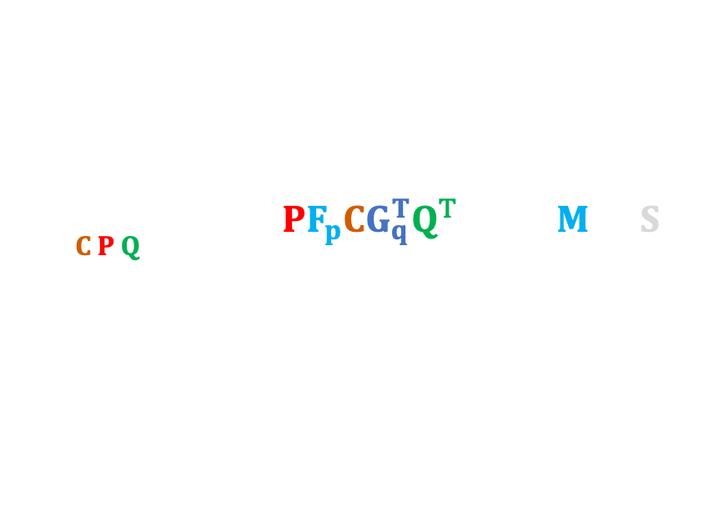
Spectral geometric matrix completion (SGMC-Z)
$$\min_{C,P,Q}{\sum_{p,q}{{ \left\|\left(ΦPF_{p}C{G_{q}^{T}Q}^{T}Ψ^{T}−M\right)⨀S\right\|}_{F}^{2}}}$$
$$F_{p},G_{q} =spectral filters$$
$$+ μ_{r} tr\left(QC^{T}P^{T}Λ_{r}PCQ^{T}\right)$$
smoothness
$$+ μ_{c} tr\left({PCQ^{T}Λ}_{c}QC^{T}P^{T}\right)$$
$$+ ρ_{r}{ \left\|off\left(P^{T}Λ_{r}P\right)\right\|}_{F}^{2} +ρ_{c}{ \left\|off\left(Q^{T}Λ_{c}Q\right)\right\|}_{F}^{2}$$
approximate
diagonalization
SGMC = a form of DMF + geometric regularization
Kovnatsky et al., 2013 ⋅ Litany et al., 2017 ⋅ Vestner et al. 2017 ⋅ Melzi et al., 2019

Slide 17
Results

Slide 18
Results
Drug-target interaction (Enzymes)
CVS1 – pair prediction; CVS2 – drug prediction (missing rows); CV3 – target prediction (missing columns)

Slide 19
Results
Drug-target interaction (protein-coupled receptors)

Slide 20
Results
Drug-target interaction (ion channels)
CVS1 – pair prediction; CVS2 – drug prediction (missing rows); CV3 – target prediction (missing columns)

Slide 21
Comparison to DMF – input density
Data: Synthetic Netflix (variant)

Slide 22
Comparison to DMF – cold start
Data: Movielens 100K

Slide 23
Conclusion
Simple spectral technique for matrix completion
Performs better than many more complex methods
Includes implicit graph learning
Variant of DMF with different parametrization + geometric priors
Useful interpretations related to shape analysis

Slide 24
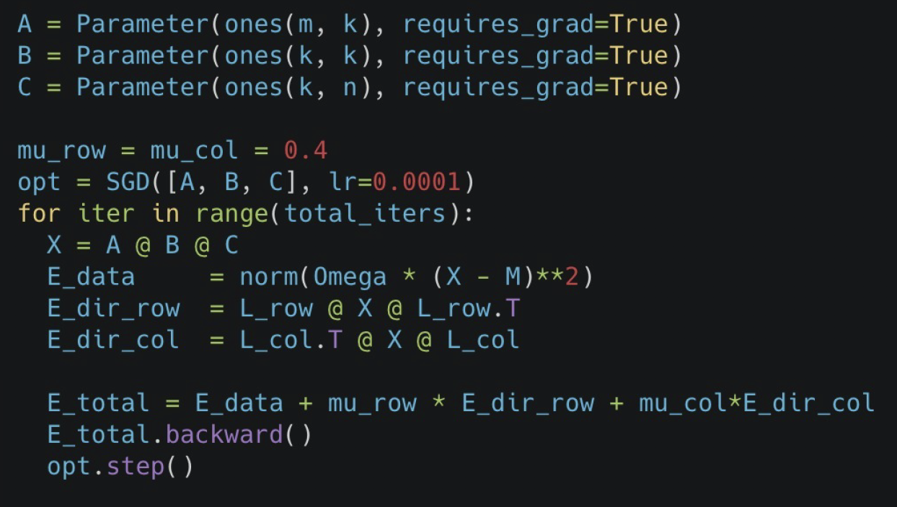
It’s simple, I mean it

Slide 25
Paper:
https://arxiv.org/pdf/1911.07255.pdf
Code: https://colab.research.google.com/drive/1OkNEiTHok14gcVf3NxFIbAFutDN6-Tx6

